Slide 1
Accurate confidence intervals on Binomial proportions, functions of proportions, algebraic formulae and effect sizes
Sean Wallis Survey of English Usage, UCL s.wallis@ucl.ac.uk

Slide 2
Outline
Thinking about statistics in terms of confidence intervals
The Binomial proportion interval
Intervals for functions of single proportions
Intervals for functions of independent proportions
Intervals for effect sizes
Conclusions

Slide 3
Thinking about statistics in terms of confidence intervals
Levin (2013)
Confidence intervals allow us to
visualise the uncertainty of observations
identify many significant/ns differences between observations
Easier to interpret than tests
tests with one degree of freedom may be visualised as an interval
But the history of CIs is littered with inaccurate formulae
non-significant difference
possibly significant difference
significant difference

Slide 4
The Binomial proportion interval
We are conventionally presented with the Normal approximation to the Binomial distribution
estimate likely position of p given P
assume that each observation is independent, has consistent chance of being True or False
this chance, P, need not be 0.5
Normal approximation: smooth a Normal curve over the Binomial
Possibly include a continuity correction
① population mean P
② standard deviation S = P(1 – P) / n
√
Ψ
③ critical value of Normal z_{α/2}, α = 0.05
z_{α/2} . S
z_{α/2} . S
2.5%
2.5%
95%
p
0.1
0.3
0.5
0.7
0.9

Slide 5
The Binomial proportion interval
We are conventionally presented with the Normal approximation to the Binomial distribution
estimate likely position of p given P
assume that each observation is independent, has consistent chance of being True or False
this chance, P, need not be 0.5
Normal approximation: smooth a Normal curve over the Binomial
Possibly include a continuity correction
① population mean P
② standard deviation S = P(1 – P) / n
√
This is a POPULATION interval
It estimates the uncertainty of observations p given P
It does not define uncertainty of P given p
Ψ
③ critical value of Normal z_{α/2}, α = 0.05
z_{α/2} . S
z_{α/2} . S
2.5%
2.5%
95%
p
0.1
0.3
0.5
0.7
0.9

Slide 6
The Binomial proportion interval
Ψ
p = E–
But… in most cases we don’t know what the population value P is
We have our observed mean, p
to model sampling uncertainty about p, we need to invert the relationship, using the same model
we need Normal⁻¹(p), not Normal(P)
= Wilson score interval (w –, w⁺)
this distribution is never Normal
asymmetric except where p = 0.5
squeezed between p = 0 and 1
Wilson (1927)
P = w⁺
z_{α/2} . S
z_{α/2} . S
E⁺
w–
w⁺
p

Slide 7
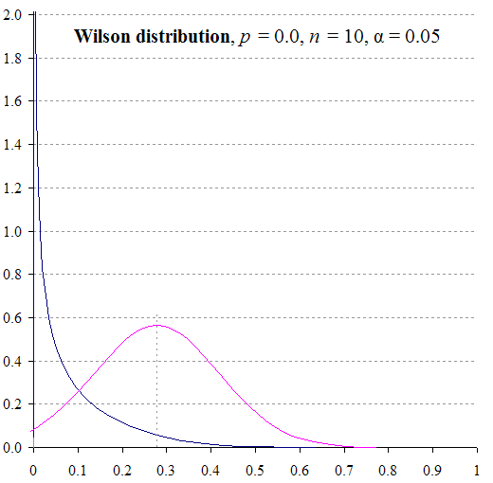
The ‘Normal fallacy’
The assumption that uncertainty is Normally distributed about an observation
The Wilson distribution
is two distributions (lower, upper)
each reflects the Normal population distribution on its inner side only
The interval is constrained p ∈ [0, 1]
distributions cannot be Normal
but they do have a relationship with the Normal distribution

Slide 8
Statistical robustness
Standard statistical methods assume
random sampling (or a good approximation) – instances are independent
population >> than sample (or infinite)
freedom to vary – the true value of p(x) can plausibly be 0 or 1
Possible to adjust formulae for random sampling or small populations
Freedom to vary
guaranteed by mutual substitution: Type A ↔ Type B (or A ↔ B₁ ↔ B₂ etc.)
semasiological change (variations in meaning share M₁, M₂… of Type A)
pooled consequence of independent choices (M₁: A ↔ B₁, M₂: A ↔ B₂ etc.)
so analytically preferable to analyse each alternation pattern independently
baseline adds information to model

Slide 9
Difference intervals
Traditionally, to compare two proportions p₁ and p₂, use a 2 × 2 contingency table (χ²)
tests if d = p₂ – p₁ = 0
We can compute an interval on difference d
employ ‘Pythagoras rule’ (Bienaymé theorem) on inner and outer intervals for p₁ and p₂ (upper right, Newcombe 1998)
w_{d}– = –$\sqrt{{\text{(}{\text{w}}_{\text{2}\text{+}} \text{–} {\text{p}}_{\text{2}}\text{)}}^{\text{2}}{ \text{+} \text{(}{\text{p}}_{\text{1}} \text{–}{ \text{w}}_{\text{1}\text{–}}\text{)}}^{\text{2}}}$
w_{d}⁺ = $\sqrt{{\text{(}{\text{p}}_{\text{2}} \text{–} {\text{w}}_{\text{2}\text{–}}\text{)}}^{\text{2}} \text{+ }{\text{(}{\text{w}}_{\text{1}\text{+}}\text{–} {\text{p}}_{\text{1}}\text{)}}^{\text{2}}}$
zero-based interval: d is non-significant if d ∈ (w_{d}–, w_{d}⁺)
repositioned for plot: (d–, d⁺) = d – (w_{d}–, w_{d}⁺)
Wallis (2021)

Slide 10
Difference intervals
Traditionally, to compare two proportions p₁ and p₂, use a 2 × 2 contingency table (χ²)
tests if d = p₂ – p₁ = 0
We can compute an interval on difference d
zero-based interval: d is non-significant if d ∈ (w_{d}–, w_{d}⁺)
testing only needed where confidence intervals partially overlap (lower right)
repositioned for plot: (d–, d⁺) = d – (w_{d}–, w_{d}⁺)
these intervals compute inner and outer bounds robustly, can be used for testing d = D
may be used to compute replication intervals
Wallis (2021)

Slide 11
Intervals for functions of single proportions
Monotonic transformations
increasing or decreasing p ∈ [0, 1]
simple change of scale
Examples:
Length 1/p
Log ln(p)
Difference q – p = 1 – 2p
Odds p / (1 – p)
Logistic ln(p) – ln(1 – p)
Increasing
interval (fn(w–), fn(w⁺))
fn(w⁺)
fn(p)
1/p
odds(p)
logistic(p)
fn(w–)
p
w–
p
w⁺
difference(p)
ln(p)

Slide 12
Intervals for functions of single proportions
Monotonic transformations
increasing or decreasing p ∈ [0, 1]
simple change of scale
Examples:
Length 1/p
Log ln(p)
Difference q – p = 1 – 2p
Odds p / (1 – p)
Logistic ln(p) – ln(1 – p)
Increasing
interval (fn(w–), fn(w⁺))
fn(p)
1/p
odds(p)
fn(w–)
logistic(p)
fn(w⁺)
p
w–
p
w⁺
difference(p)
ln(p)
Decreasing
interval (fn(w⁺), fn(w–))

Slide 13
Intervals for functions of single proportions
Non-monotonic transformations
contain turning point(s)
local maxima or minima
Examples:
Product of alternate rates p(1 – p)
Squared difference terms (p – P)²
If interval for p contains max m ̂
interval (min(fn(w–), fn(w⁺)), m ̂)
If interval for p contains min m
interval (m, max(fn(w–), fn(w⁺)))
fn(p)
(p – P)²
local maximum
m ̂
fn(w–)
p(1 – p)
fn(w⁺)
̌
P = 0.3
p
̌
w–
w⁺

Slide 14
Intervals for functions of two independent proportions
Zou and Donner (2008) proposed a theorem for the difference between two independent parameters, θ₁ – θ₂
Generalisation of Newcombe (1998) for d = p₁ – p₂ to θ₁ = fn(p₁), θ₂ = fn(p₂) l₁ and u₁ are bounds of fn(p₁) etc.
L = θ₁ – θ₂ – $\sqrt{{\text{(}{\text{θ}}_{\text{1}} \text{–} {\text{l}}_{\text{1}}\text{)}}^{\text{2}} \text{+ }{\text{(}{\text{u}}_{\text{2}} \text{–} {\text{θ}}_{\text{2}}\text{)}}^{\text{2}}}$
U = θ₁ – θ₂ + $\sqrt{{\text{(}{\text{u}}_{\text{1}} \text{–} {\text{θ}}_{\text{1}}\text{)}}^{\text{2}}{ \text{+} \text{(}{\text{θ}}_{\text{2}} \text{–} {\text{l}}_{\text{2}}\text{)}}^{\text{2}}}$
Examples:
Sum s = p₁ + p₂, θ₁ = p₁, θ₂ = –p₂
Ratio r = p₁ / p₂
take logs: ln(r) = ln(p₁) – ln(p₂), θ₁ = ln(p₁), θ₂ = ln(p₂)
ratio
sum
product
ϕ
difference
Wallis (forthcoming)

Slide 15
Intervals for effect sizes
Effect sizes are scalar measures of multi-dimensional differences
Collapse the mean or sum of differences into a single aggregate score
Example:
Cramér’s ϕ for χ² tables
2 x 2 ϕ = geometric mean of differences on each axis ϕ = $\sqrt{{\text{d}\text{(}\text{x}\text{)}}^{\text{2}} \text{×} {\text{d}\text{(}\text{y}\text{)}}^{\text{2}}}$
ϕ interval obtained from geometric mean of NW difference intervals for d(x) and d(y).
Wallis (2021)

Slide 16
Conclusions
An effective visualisation of uncertainty enhances our understanding of our data and variables
Basis for an ‘algebra of intervals’
intervals for wide range of properties
outperforms standard-error based methods
Wilson method corrects for Normal fallacy
corrected for continuity, random text sampling
Enabling novel experiments
plotting intervals on effect sizes
new significance tests (e.g. comparing ϕ scores)
comparing experimental outcomes
Wallis (forthcoming)

Slide 17
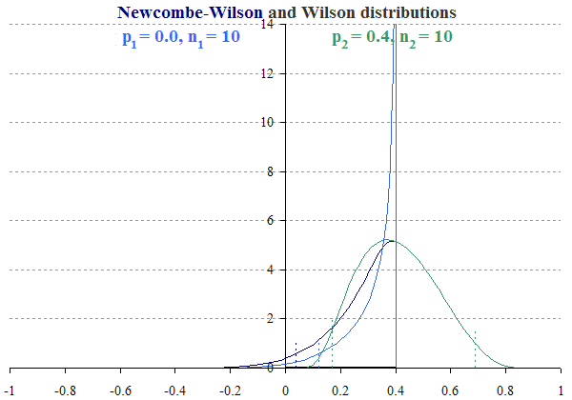
Teaching thinking about statistics
Encouraging experimentation
identifying and challenging assumptions
experimenting with different baselines
Visualising data with confidence intervals
understanding uncertainty of results
Reasoning with confidence intervals
seeing differences between observations
validating data efficiently
Visualising confidence distributions
e.g. difference intervals (right)

Slide 18
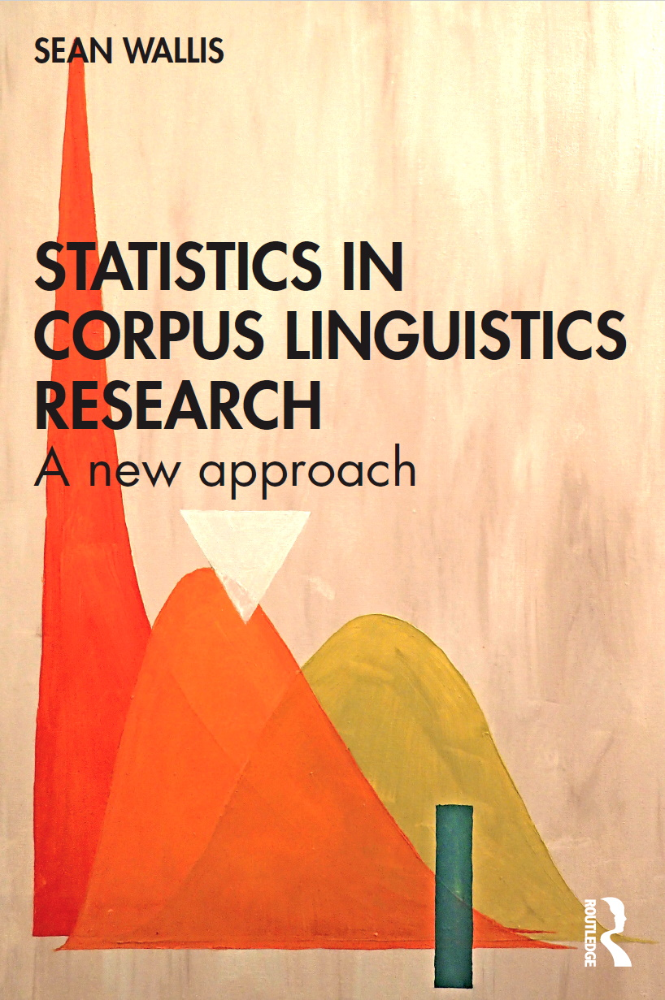
References
Levin, M. 2013. The progressive verb in modern American English. In B. Aarts, J. Close, G. Leech & S.A. Wallis (eds.) The Verb Phrase in English. Cambridge: Cambridge University Press
Newcombe, R.G. 1998. Interval estimation for the difference between independent proportions: comparison of eleven methods. Statistics in Medicine, 17, 873-890
Wallis, S.A. 2021. Statistics in Corpus Linguistics Research: a new approach. New York: Routledge
Wallis, S.A. forthcoming. Accurate confidence intervals on Binomial proportions, functions of proportions, algebraic formulae and effect sizes. London: Survey of English Usage. Available at: https://corplingstats.wordpress.com /2021/04/24/accurate-confidence-intervals
Wilson, E.B. 1927. Probable inference, the law of succession, and statistical inference. Journal of the American Statistical Association, 22(158), 209-212
Zou, G.Y. & A. Donner 2008. Construction of confidence limits about effect measures: A general approach. Statistics in Medicine, 27(10), 1693-1702

