Slide 1
Stop, Collaborate and Listen: how to reduce wasted RSE effort
Centre for Advanced Research Computing
Connor Aird – Assistant Research Software Engineer
c.aird@ucl.ac.uk

Slide 2
Thirring-rhmc
RSE
PI
Prof Simon Hands
Dr Johann Ostmeyer
Connor Aird
Dr Jamie Quinn
Dr Jude Worthy
Notes:
Thirring-rhmc is the name of a code repository
Our collabration was funded by DiRAC a high performance computing facility and RSE community.
Myself and Jamie Quinn played the role of RSE and Professor Simon hands was the PI for the project.
To other members of Simon's group also provided support, Johan and Jude
A key thing to mention is, due to commitments and Christmas, we had a tight deadline of 5 weeks to complete the project.

Slide 3
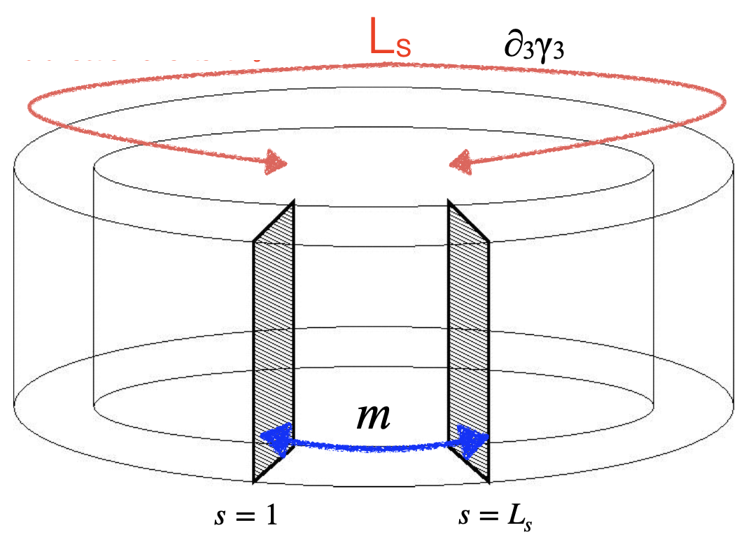
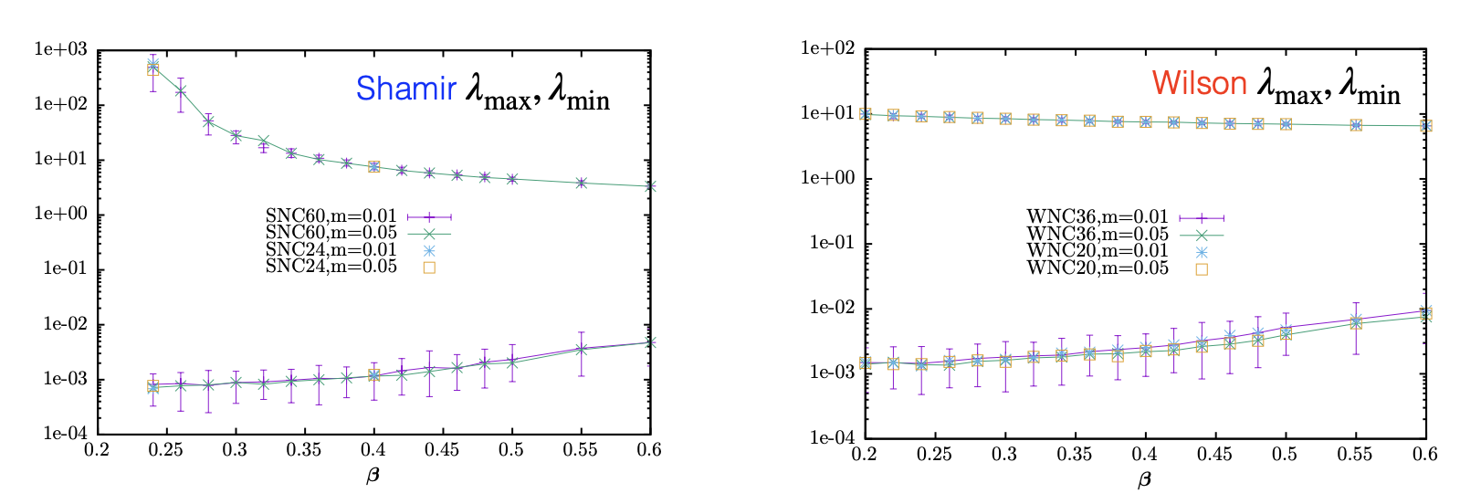
Thirring-rhmc
Notes:
The code models something called the Thirring Model in 2+1 dimensions (2 spacial and one time dimension) with Domain Wall Fermions
The thirring model is a quantum field theory which describes the self-interactions of a Dirac field
I don't really know what that means, so don't worry if you don't either.
The key point is there was a lot of specific domain knowledge needed to understand what the code base was doing.
A key thing to note is the two graphs with results produced by two different versions of the model, Shamir and Wilson.
Our task within thirring-rhmc was to add this Wilson version to the code base.

Slide 4
Thirring-rhmc
Notes:
Removing the confusing stuff we can see the key information
The code is written in Fortran and we need to implement the Wilson kernel
Helpfully, this kernel had already been implemented by a PhD student.
So then, what do we need to do? Why are we here?

Slide 5
Thirring-rhmc
E2E
Integration
Unit
Notes:
Unfortunately this Wilson Kernel had been written using a very old version of thirring-rhmc and version control had not been used
Therefore,
no history.
no git commands to merge the two codes.
Multiple versions of the same files with slightly different names.
How do we solve this?
With tests
If we have tests in place we'll know if we break anything while we copy, paste and tinker with the code.

Slide 6
Thirring-rhmc
Why?!?!
What tests?
Notes:
Luckily for us there was a test directory in the repository, however...
These tests were not being maintained and no one knew anything about them.
We found out that an had implemented these tests
Since then the tests had been abandoned, not maintained and not even used.
Therefore, the effort of that RSE was, to some degree, wasted.
How does this happen?

Slide 7
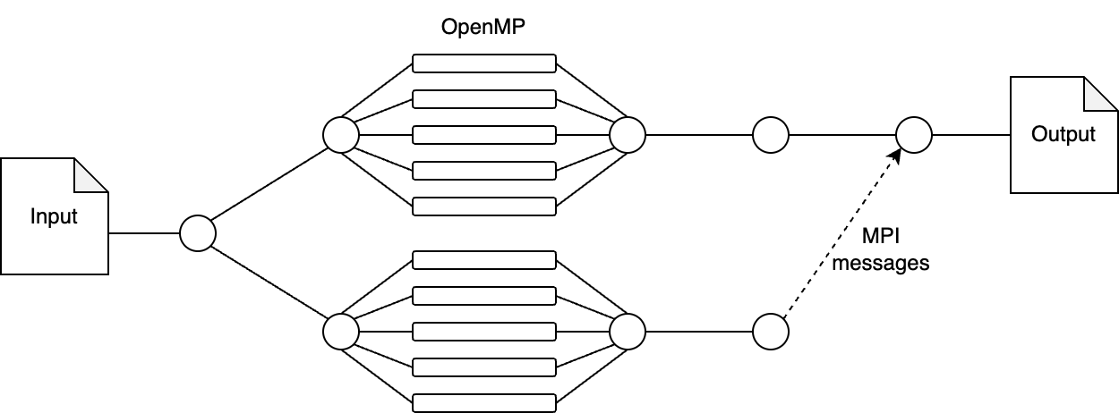
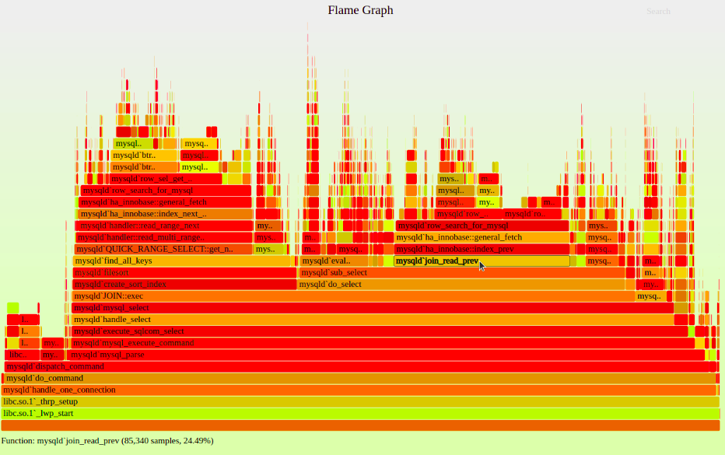
Ideal PI outcomes
Notes:
The ideal outcomes from the PI's point of view would included
performance improvements possibly by parallelising with OpenMP or OpenMPI
Profiling the code to understand where most of the time is being spent and where performance gains could be made
And, of course, the addition of the Wilson kernel to the code base

Slide 8
Ideal RSE outcomes
E2E
Integration
Unit
STOP
Notes:
From the RSE's point of view the ideal outcomes may be
Adding the Wilson kernel of course
But possibly refactoring the code into a nice shiny new language such as Julia
Creating comprehensive documentation and hosting it on a read the docs site
Getting 100% coverage with automated tests that running github actions or some other continuous integration tool
But this is where we should STOP
As there is a risk the project could fail if we do this.

Slide 9
The risk
Notes:
Remembering how confusing the physics of the code was to us.
We would be unable to take this research forward ourselves without some serious effort to upskill via something like a PhD

Slide 10
The risk
E2E
Integration
Unit
Notes:
It is a similar issue for the PI.
They would struggle to take these processes forward and likely end up ignoring them
Hence we would have a lot of wasted effort.

Slide 11
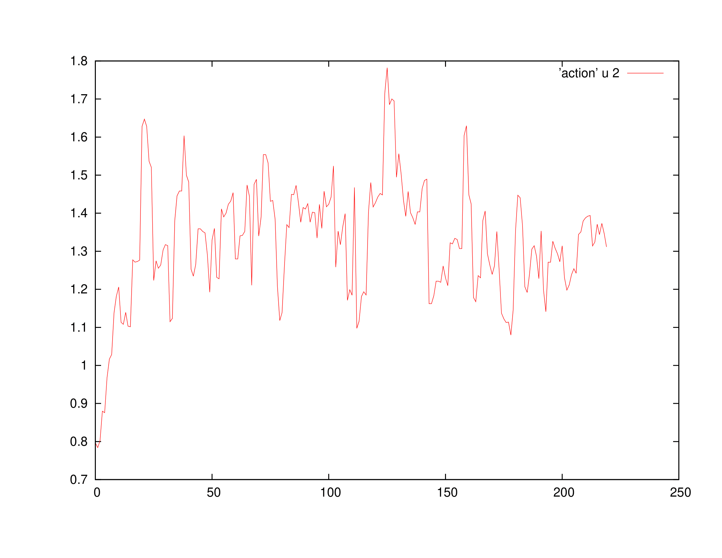
Writing tests
Thirring-rhmc test output
COLLABORATE
Output
Trajectories
Notes:
Another risk was the need to write tests before any changes could be made to the source code.
However, the output of thirring-rhmc, which you can see an example of here, is stochastic and can change drastically with only small changes to the code.
Hence, is was unclear what outputs we could use for reliable tests.
After talking to the PI we learnt that anything within a region like the one shown would be an accepted output and the number of accepted points (the acceptance rate) is a clear indicator of code correctness.
Therefore, we can see how it was vital to LISTEN to the PI to successfully complete the project within the tight timeframe

Slide 12
The compromise What we didn't do
Notes:
To manage this risk it is necessary to compromise meaning somethings can't be done within the project.
For example we didn't
Run profiling
Parallise the code
Refactor to Julia
Intorduce CI and some complex agile release process.

Slide 13
The compromise What we did do
LISTEN
Notes:
This then ensures we are able to complete the key aspects of the project, such as
The Wilson Kernel
Adding basic tests
Creating documentation for our changes and how to use the test
And Demoing the tests
This shows how effectively COLLABORATING produces a sucessful project

Slide 14
Outcomes
SUCCESS!
Notes:
So success right?

Slide 15
Outcomes
Have you continued to use the tests we wrote?
Notes:
Let's check in

Slide 16
Outcomes
FAIL!?
No, I haven't used the tests
Notes:
Ah so possibly not completely removed wasted effort.

Slide 17
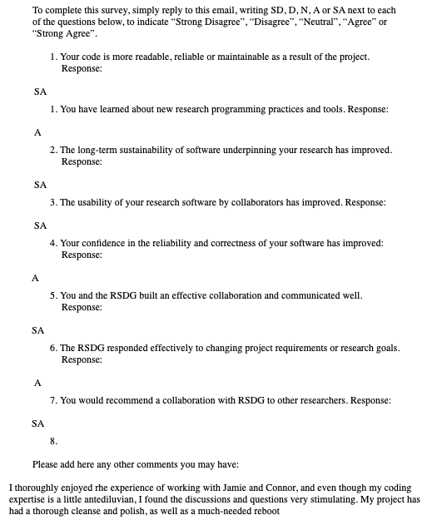
Outcomes
Notes:
However, we received very positive feedback from the PI
So definitly a success

Slide 18
Summary
STOP and evaluate the risks
COLLABORATE with the PI to remove blockers
LISTEN to what they actually need for the project

Slide 19
Summary
Outcomes
✅ Added the Wilson Kernel
✅ Created tests to help implement the kernel.
❌ These tests may never get used again by the PI.
✅ Maintained a good Relationship with the PI.
Takeaways
❌ It is very difficult to completely prevent wasted effort
✅ RSE effort can be useful for future RSEs, if not PIs

Slide 20
Thank you
Questions?

