Slide 1
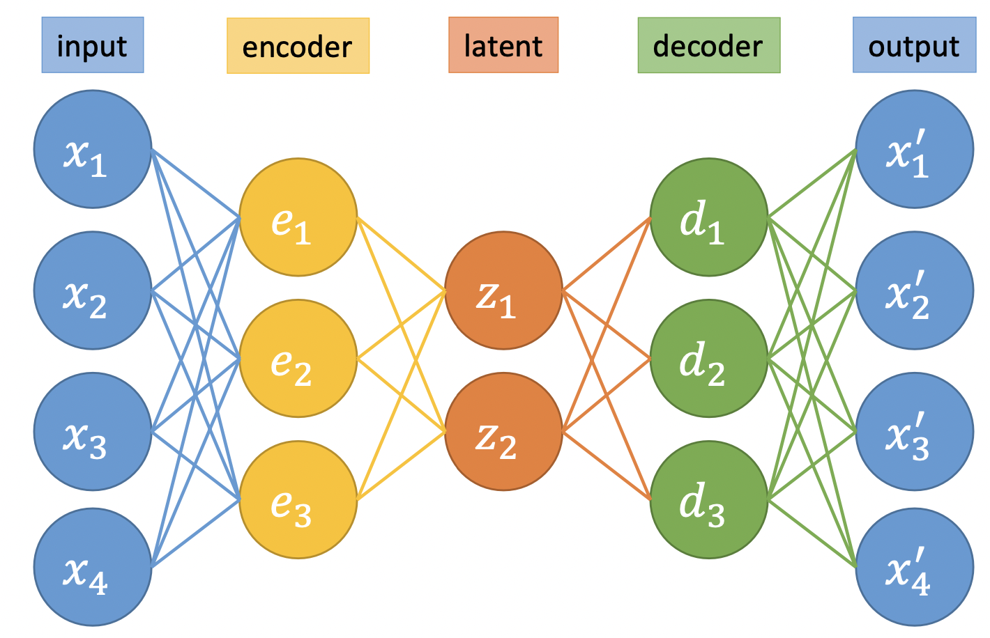
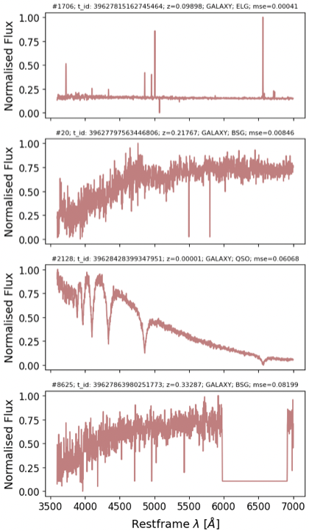
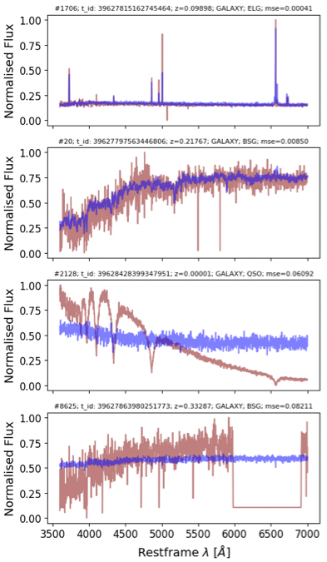
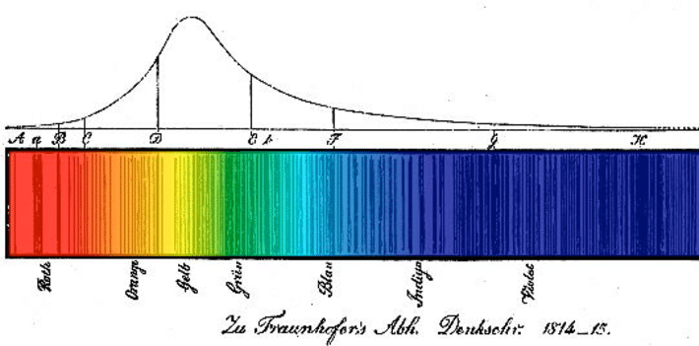
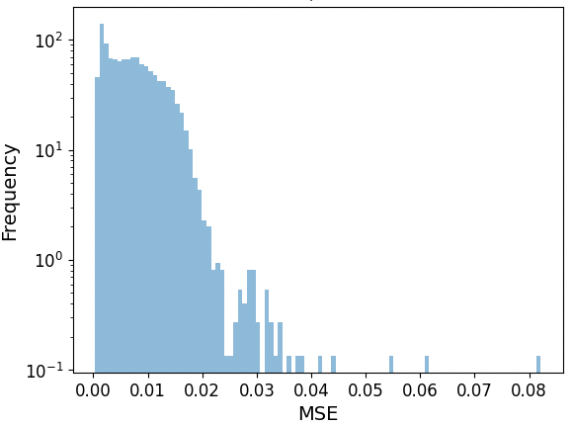
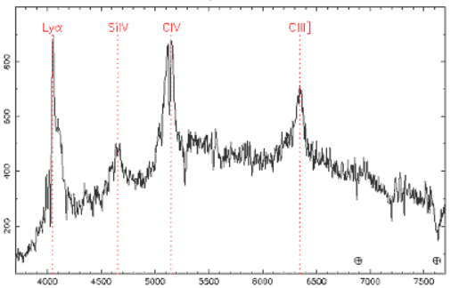
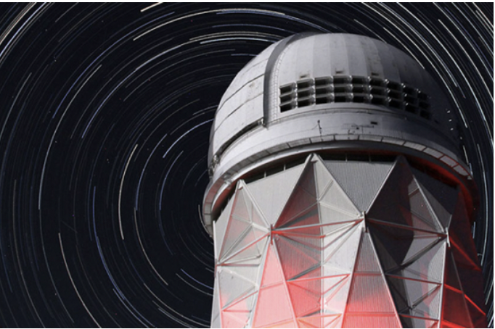
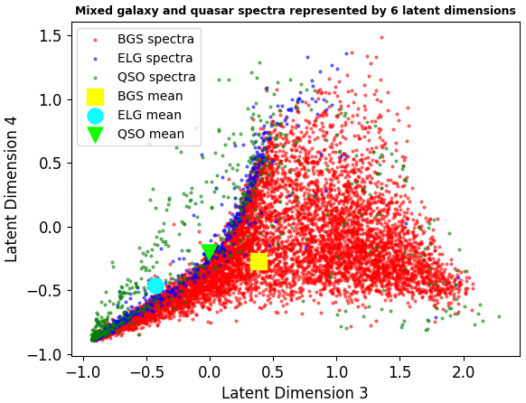
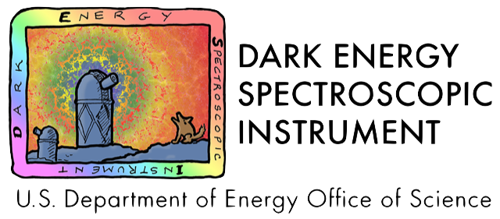
Scouring the Universe for the Unusual
Anomaly Detection in DESI Spectra using Autoencoders and other Machine Learning Techniques
Phyisics and Astronomy
Paul Nathan (supervisor – Ofer Lahav) CDT Data Intensive Science
A little background on:
We’re hunting for anomalies to help us better understand the Universe
Astronomical Spectra
Autoencoders
We’re searching millions of previously unseen galaxy spectra using an autoencoder
First studied in detail by Joseph Fraunhofer in 1814. He noticed lines in the rainbow or spectrum created by passing sunlight through a prism.
He correctly surmised it was specific elements which were absorbing light at specific wavelengths.
Credit: Portillo et al, 2020
DESI Spectra
(deredshifted)
Reconstructed Spectra
If a spectrum is an outlier compared to the norm, a trained autoencoder will find it
Autoencoder
Credit: ResearchGate
A neural network that learns efficient codings of unlabelled data by compressing them into a lower dimensionality - the latent space
Consists of encoder and decoder layers with latent space in between. Uses non-linear activation functions
Non-linearity allows more efficient reconstruction of galaxy spectra structure than with PCA [1], [2]
Anomalies can be identified as outliers in this reconstruction.
the latent space can be used to separate classes of object and aid interpretability
- Autoencoder anomaly detection has a wide range of applications beyond astrophysics, e.g. medical imaging and finance.
Mean Squared Error
Today, astronomical spectra are used for a wide range of applications from identifying objects; working out their redshift which says how far away and old they are; and understanding their chemical compositions and physical processes.
- Spectra are obtained through large-scale spectroscopic surveys like DESI
Latent Layer
Encoder
Decoder
Anomalies
We’ll be using Anomaly Detection to help find:
Spectra with technical problems so that scientists can correct for them
Rare astronomical objects which can then be studied in detail
DESI
Credit: 2dF Quasar Survey
Dark Energy Spectroscopic Instrument
- Conducted from Mayall 4-meter telescope at Kitt Peak National Observatory
And within the huge haystack of fresh DESI spectra we’re hoping to discover something completely new that will push forward the frontiers of physics
Anomalies
Anomalies are objects that differ significantly from the majority of data being studied. There are two types:
- Outliers
training set contains both typical and atypical data
Can be indentified by looking for Isolated points in latent space representation [1]
- Novelties – e.g. a new type of galaxy or star
Training set contains typical data and used to test whether new observation is an outlier
Reconstruction error used for novelty detection [3]
The lower-dimensional – latent – representation that autoenconders create encode correlations between spectral features, reflecting underlying physical properties, and can separate different types of object.
So far we’ve been using tens of thousands of spectra. The next step is to scale up to tens of millions, thereby hugely increasing the discovery potential.
Credit: www.desi.lbl.gov
- Targeting ~40 million pre-selected galaxies across one-third of the night sky
The DESI optical corrector was built at UCL
Science and Technologies Funding Council (STFC) contributed to DESI project
Acknowledgements
A huge thank you to my supervisor, Ofer Lahav, the UCL CDT DIS Management team, the DESI Collaboration and to STFC for their support
References: [1] Dimensionality Reduction of SDSS Spectra with Variational Autoencoders – Portillo et al (2020); [2] Spectral Classification of Quasars in the Sloan Digital Sky Survey – Yip et al [2004]; [3] Neural network-based anomaly detection for high-resolution X-ray spectroscopy – Ichinohe and Yamada (2019)
More information: ucaprpn@ucl.ac.uk

