Slide 1
Open access briefing
Spring 2023
Catherine Sharp
openaccess@ucl.ac.uk

Slide 2
Key points
Making publications OA
Gold – fully OA journals, journals in UCL’s transformative agreements
Green – RPS and UCL Discovery
REF and UCL OA policies
Research funders’ OA policies
What authors need to do before submitting
UCL’s UKRI/Wellcome open access webpages

Slide 3
What is Gold open access?
OA on the journal/book website
Re-use under Creative Commons licences
Article/Book Processing Charges
Fully OA journals and platforms: https://doaj.org/ - e.g. MDPI, PLOS, BMC
Central funding for UKRI, Wellcome, CRUK, BHF and unfunded papers
MRC units pay the charges for fully OA journals unless another relevant grant is acknowledged
Grant funding for NIHR, EC, ERC
Funding information
UCL corresponding authors can publish Gold OA in subscription and fully OA journals in UCL’s transformative agreements

Slide 4
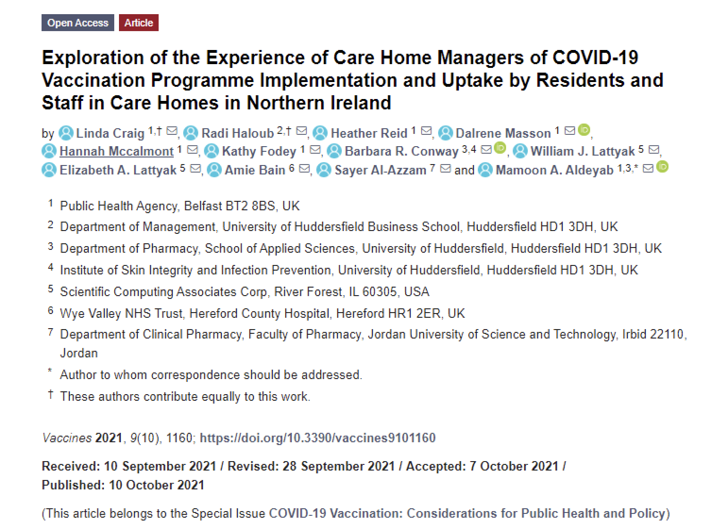

Slide 5
What is Green open access?
Making research freely available in an OA repository
Subscription journals and many book publishers allow this, currently after an embargo
If your paper isn’t Gold open access, upload your accepted manuscript to RPS (and EPMC)
UCL’s Open Access Team makes the accepted manuscript OA in UCL Discovery

Slide 6
What does UCL require?
Authors much record outputs in UCL’s Research Publications Service (RPS)
For papers that aren’t Gold open access, upload your accepted manuscript to RPS, on publication
Papers are made open access in UCL Discovery after the publisher’s embargo period
Make sure that you maintain your list of publications in RPS, regularly reviewing suggestions and claiming or rejecting publications, and uploading your accepted manuscripts
Quick guide
How to use RPS

Slide 7
Do any other policies affect me?
Where you choose to publish, and how you make your paper open access, will depend on your funder’s policy
UKRI, Wellcome, EC, CRUK and NIHR require open access on publication, under the CC BY licence
Embargoes on Green open access are not permitted
Funders’ open access policies
Notes:
If it’s not fully OA, and it’s not in a TA – last resort to comply is rights retention

Slide 8
Where can I publish (UKRI/Wellcome)?
Fully open access journals https://doaj.org/ (Gold)
Hybrid (subscription) journals in transformative agreements (Gold)
See journals, agreements and eligibility criteria
Hybrid (subscription) journals NOT in transformative agreements (Green) that allow immediate OA to the accepted manuscript under CC BY (e.g. Science, ACM, Royal Society)
For these journals, upload to RPS on publication Also upload MRC- and BBSRC-funded papers to Europe PubMed Central

Slide 9
How can I publish in a non-compliant journal (UKRI/Wellcome)?
Include the UKRI/Wellcome submission statement in all submissions, covering letters and funding acknowledgements.
Before submission, ask the journal to allow you to make the accepted manuscript open access on publication, in a repository, under the CC BY licence (Green open access)
Upload your final accepted manuscript to RPS on publication - and also, for MRC- and BBSRC-funded papers, to Europe PubMed Central

Slide 10
What do I need to do/know now?
Check funder-specific guidance on UCL’s open access webpages
Check whether your preferred journals are in UCL’s transformative agreements, and follow the guidance on submitting to these journals
If you’re submitting to a fully open access journal, check whether funding is available before you submit
Maintain your publications list in RPS
Unless your paper is Gold open access with a Creative Commons licence, upload your accepted manuscript to RPS, on publication

Slide 11
UKRI-funded long-form outputs
Open access no later than 12 months after publication under CC BY or another CC licence
monographs, book chapters and edited collections
acknowledging funding from AHRC, BBSRC, EPSRC, ESRC, MRC, NERC, STFC, Innovate UK
published on or after 1 January 2024
Third party materials may carry a more restrictive licence, or be exempted
Out of scope: trade books, scholarly editions, exhibition catalogues, textbooks, fiction
Some funding will be available for open access for long-form outputs

Slide 12
UKRI-funded long-form outputs 2
Definition of a monograph (including edited collections)
Monographs are defined in the policy as ‘a long-form publication which communicates an original contribution to academic scholarship on one topic or theme and is designed for a primarily academic audience… it may be written by one or more authors’.
Definition of a trade book
The decision of whether a book should be considered a trade book or an academic monograph, is at the discretion of the author and publisher. Trade books are defined in the policy as ‘an academic monograph rooted in original scholarship that has a broad public audience’.
Definition of scholarly editions
Defined as an edition of another author’s original work or body of works informed by critical evaluation of the sources (such as earlier manuscripts, texts, documents and letters), often with a scholarly introduction and explanatory notes or analysis on the text and/or original author

Slide 13
UKRI-funded long-form outputs 3
Third-party rights
UKRI’s licensing requirements do not apply to any materials included within a long-form output that are provided by third-party copyright holders. Academic books published under a CC BY, or other Creative Commons licence, may include third-party materials (such as images, photographs, diagrams or maps) which are subject to a more restrictive licence. UKRI considers this approach compliant with its policy.
Third-party rights – exceptions
UKRI recognises that there may be some instances where permissions for reuse in an open access book cannot be obtained for all third-party images or other materials. Therefore, an exception to the policy may be applied when reuse permissions for third-party materials cannot be obtained and there is no suitable alternative option available to enable open access publication.

