Slide 1
Co-design with partners from the public from underserved communities: Developing Forward with Dementia, a website for post-diagnostic dementia support.
Jane Wilcock, Claudio Di Lorito, Maud Hevink, Greta Rait, Monica Leverton, Kritika Samsi, Jill Manthorpe Louise Robinson, Marie Poole
Bill, Margaret and Jane
Notes:
Add logo (UM) and name here

Slide 2
Outline for today
To share the background to “Forward with Dementia
To outline the different stages of the study and how data fed into the co-design process

Slide 3
Background
“When I was first diagnosed, I felt lost and so overwhelmed. I didn’t know where to turn”
People living with dementia and their carers often have negative experiences of NHS and social care services around diagnosis. They have told us there is often little support and information
Many people living with dementia use homecare services to support them living at home. Most homecare workers often work alone, lack specific dementia training and are not confident in their roles.

Slide 4
Aim and objective
Forward with dementia: co-producing support for social care needs after a dementia diagnosis is a one year study funded by the NIHR Three Schools: Dementia Research Programme
Aim: To support people living with dementia and carers to live well after a dementia diagnosis and to help people in social care who are working with them.
Objective: To expand an information website and personalised toolkit called Forward with dementia aimed at providing post-diagnostic support for people living with dementia and carers, by adding information and guides for social care practitioners, particularly people working in homecare, to help support their clients.
https://www.forwardwithdementia.org/en/

Slide 5
Design and sampling
A qualitative experience-based co-design approach in partnership with people living with dementia, carers, and health & social care professionals.
Participants were recruited through creating networks and snowballing techniques, public co-apps and partners, local authorities, third sector organisations (e.g., Alzheimer’s Society), local and national home care agencies, Join Dementia Research, Dementia Engagement and Empowerment Project (DEEP), local community events (e.g., dementia cafes), social media, and events/conferences.
We purposively recruited through a dedicated Equality, Diversity and Inclusion (EDI) strategy, to ensure that we captured the diversity of views/needs of contemporary society. We were able to involve participants of different ages, ethnicities, types of dementia, professions, religious & cultural backgrounds, sexual orientation, socio-economic backgrounds, and locations across England

Slide 6
Data collection/analysis
Work Package 1
Qualitative interviews with participants living with dementia, caregivers and professionals.
Data analysed thematically to identify information and support needs following a dementia diagnosis.
Work package 2
Workshops with participants living with dementia, carers and professionals.
Themes from WP1 presented to guide discussion, new ideas integrated, website prototype generated
Work package 3
User-testing with people living with dementia, caregivers and professionals. Website prototype presented, navigation observed. A talking aloud approach adopted to gather feedback on content, visuals, usability.
Feedback collected onto change tracker and passed to website developer. Iterative process where new prototypes were generated and presented to new user-testers.
PPI partnership
Throughout the project, bi-monthly meetings with PPIE partners from diverse backgrounds to further generate feedback for website improvement.
Feedback integrated onto the change tracker.

Slide 7
Findings
82 participants: 10 people living with dementia, 33 caregivers, and 39 professionals.
59 Female, 22 male, 1 identifying as neither. Age ranged from 18 to 90 years old.
Ethnic representation from different communities including White, Black, Asian, and Jewish. A mix of nationalities and of languages including English, Polish, Gujrati and Yiddish.
A range of professions supporting people living with dementia including Occupational Therapist, Physiotherapist, Nurse, Homecare worker, Volunteer, Social worker, Care/service manager/coordinator, Retired (previously in Health and Social care), Support worker, Care home worker, Medical professional
All regions in England

Slide 8
Themes from interviews/workshops
Theme 1: Fulfilling post-diagnostic information needs
This theme identifies characteristics of information / resources to enable people living with dementia and their informal caregivers to learn about, navigate and access dementia support services after receiving a diagnosis).
Information and resources need to be timely (i.e., readily available post-diagnosis), useful (i.e., to learn what is available, when, where and how), accessible (i.e., retrievable and usable), and inclusive (i.e., diverse, culture-specific).
Theme 2: Fulfilling home care support needs
This theme focuses on ways in which professionals can fulfil the home care support needs of a person living with dementia to be able to safely live in their own home and delay access to care home.
These include providing tailored care, dealing effectively with dementia-specific barriers to care, offering culture-sensitive care, communicating effectively with clients, involving caregivers in the care process

Slide 9
Preliminary themes from secondary analysis
Focus on caregiver burden and home care
This secondary analysis was part of the Inter-act Fellowship by Alzheimer Netherlands
The social care system
Provision of social care
Staff
Accessing care
The carer

Slide 10
It’s the carer’s health, probably, because the carer will put up with all sorts of upsetting situations and be doing things that they never thought that they would have to do with someone, you know, that they loved, etc. But it probably is the breakdown of their own health that would be the crux.
Carer burden
sometimes think that they just want you to give up. The make life so difficult for you that you you you get to the point and and I have got to the point where I thought you know what? I just give up. I'm. I'm I'm not. I'm not doing this anymore
Accessing care
Notes:
sometimes think that they just want you to give up. The make life so difficult for you that you you you get to the point and and I have got to the point where I thought you know what? I just give up. I'm. I'm I'm not. I'm not doing this anymore and I'm sure. I'm sure that's what it's all about.
0:22:15.640 --> 0:22:19.540 Bill Not that I ever give up 1:37 ¶ 262 – 265 in C14 - transcript.docx

Slide 11
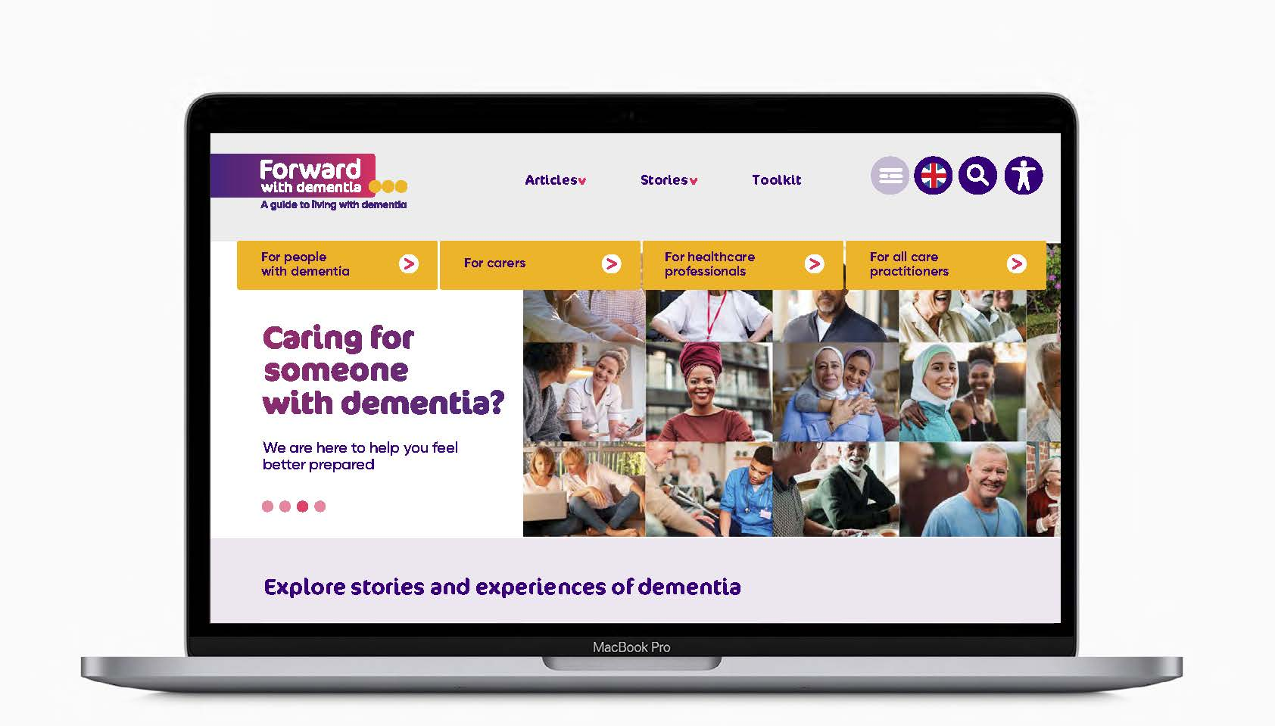
Themes were translated into content and design for the first prototype of the website
User-testing of the prototype began
Feedback from user-testing was integrated into subsequent prototypes

Slide 12
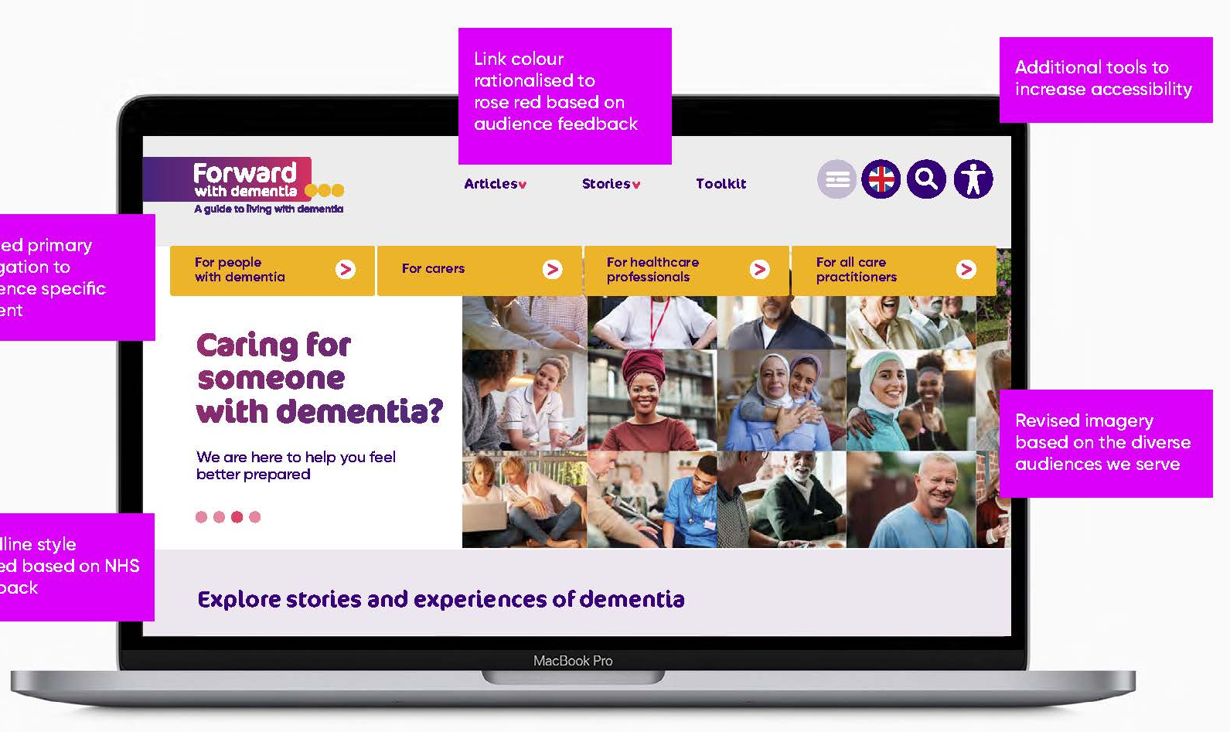
Changes resulting from user testing
Link colour rationalised to rose-red based on audience feedback
Additional tools to increase accessibility
Revised primary navigation to audience-specific content
Revised imagery based on the diverse audiences we serve
Headline style revised based on NHS feedback

Slide 13
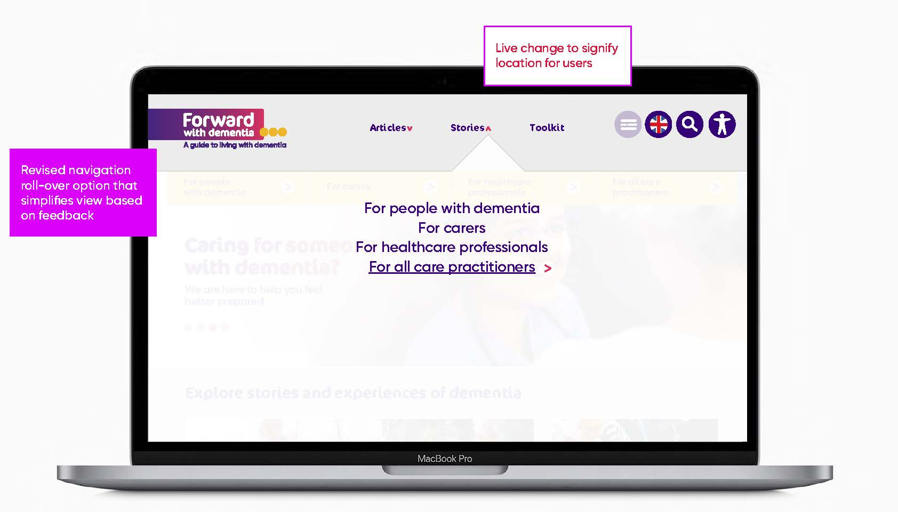
Changes resulting from user testing
Live change to signify location for users
Revised navigation roll-over opt on that simplifies view based on feedback

Slide 14
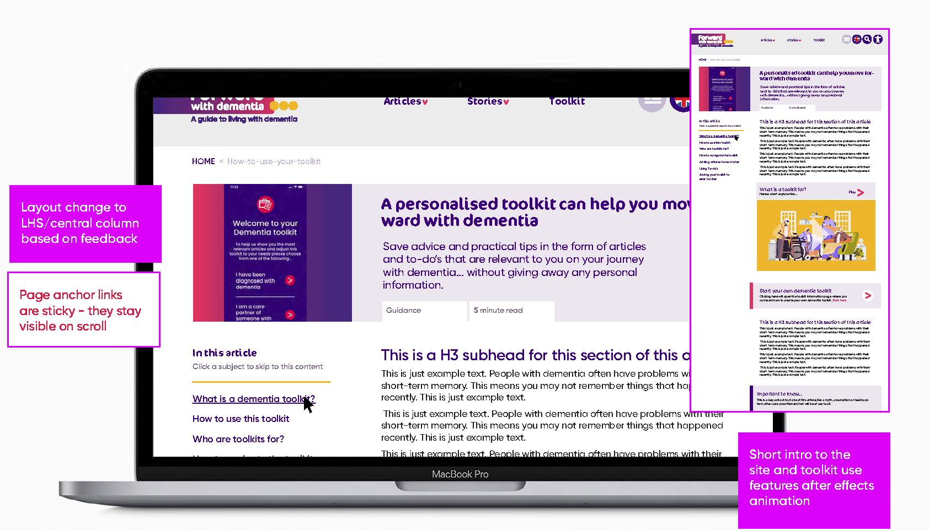
Changes resulting from user testing
Layout change to LHS central column based on feedback
Page anchor links are sticky – they stay visible on scroll
Short intro to the site and toolkit use features after effects animation

Slide 15
What is next?
Website finalised and launched by the end of April
To create video content and a social media campaign with translations
Dissemination events, engagement with key audience groups and wider public

Slide 16
Acknowledgements
Alzheimer’s Society and the NIHR Three Schools Dementia research Programme
Co-production partners: People living with dementia, carers and practitioners
Partners in the COGNISANCE Collaboration
This 12-month study/project is funded by the NIHR SSCR. The views expressed are those of the researcher team, and not necessarily those of the NIHR or the Department of Health and Social Care

Slide 17
Thank you!
For further info, please contact:
Claudio Di Lorito
Email: Claudio.dilorito@ucl.ac.uk

Slide 18
Website: https://www.forwardwithdementia.org/en Twitter: @ForwardDementia Instagram: https://www.instagram.com/forwardwithdementia_gb/ Facebook: https://www.facebook.com/ForwardDementiaGB You Tube: Forward with dementia International

