Slide 1
Comparing hypotheses for Pliocene tropical warmth
Chris Brierley & Alexey Fedorov
Yale University

Slide 2
Outline
When was the Pliocene?
What did the Pliocene climate look like?
Why was the Pliocene climate like that?
Carbon dioxide increase
Movement of Indonesia and New Guinea
Emergence of Isthmus of Panama
Increase in Tropical Cyclones
Cloud property changes
Summary

Slide 3
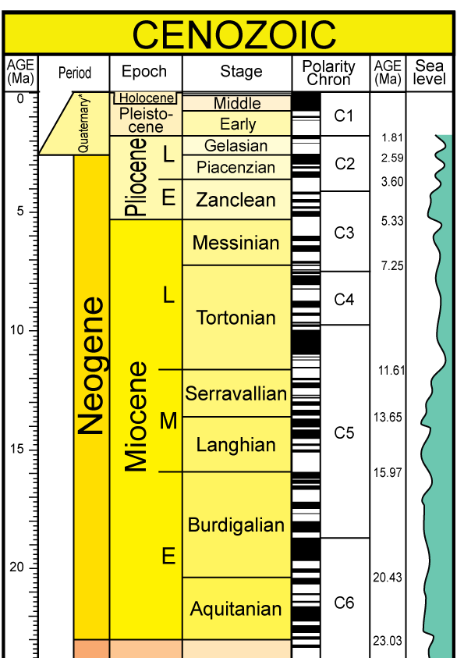
When?
Time period spanning 5.3~3.6 million years ago
I’ll use 4Ma in this talk
A relatively-short and recent period in the geological past.
Deep time in view of most climate scientists inc. IPCC
Notes:
This is an old geological timescale: the Gelasian is now part of the Pliocene.

Slide 4
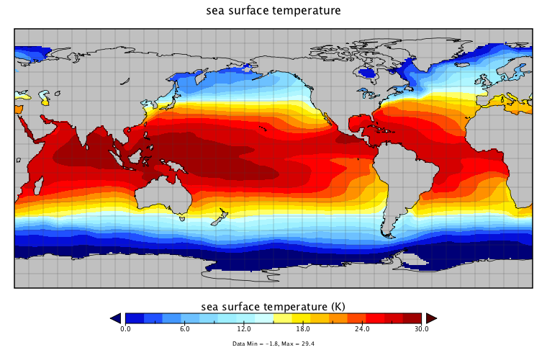
Zonal SST gradient
Equatorial SSTs were much more uniform in Early Pliocene
Zonal SST gradient was weaker, with some records suggesting non-existent
Sometimes called a “Permanent El Niño”
Fedorov et al.: Review in prep

Slide 5
Meridional SST gradient
Warm coastal upwelling regions at ~30ºN
Very weak meridional SST gradient in tropics
Polar Amplification: high latitudes warm more than tropics
Brierley et al., Science, 2009

Slide 6
Reconstruction: a vast warm pool
Sea Surface Temperature (ºC)
Sea Surface Temperature (ºC)

Slide 7
Ice Content
Sea level was >10 of meters higher
By more than the equivalent of both West Antarctica and Greenland Ice Sheets (green)
East Antarctic partially melted
Naish et al., Nature, 2009

Slide 8
What?
A warm world in geologically recent past
Significantly warmer poles (without ice)
Very weak temperature gradients in the Tropics
Probably unrelated to solar forcing (too long/stable for orbital variability, but too short for stellar evolution)
So why was this climate so warm?

Slide 9
Why?
At least 5 possible explanations hypothesized:
Carbon dioxide increase
Movement of Indonesia and New Guinea
Emergence of Isthmus of Panama
Increase in Tropical Cyclones
Cloud property changes
But which, if any, can explain the vast warm pool?

Slide 10
Model Framework
Test sensitivity of tropical climate to each hypothesis individually
Using NCAR’s Community Earth System Model (CESM)
Newly released model to be included in next IPCC
Low resolution version aimed at Paleoclimate work
T31 in atmos. (~3.75º) and ~3º in ocean (better at Eq)
Atmosphere (CAM4), ocean (POP2), sea ice (CICE) and land surface (CLM4) models coupled together
All simulations for 500 years starting from preindustrial control conditions (figures show average of last 50yrs)

Slide 11
A) Carbon Dioxide
Still large uncertainty as to the actual value
Small carbon dioxide increase up to at most 400pm (comparable to today’s elevated value)
Fedorov, Lawrence, Brierley, Liu & Dekens: Review in prep
Notes:
Describe the axes

Slide 12
CO₂ in ModelS
+100ppm SAT CESM
IPCC, Ensemble Mean Pattern
IPCC, AR4, fig 10.8

Slide 13
Impact on Trop. Pac.

Slide 14
Model Dependent?
The majority of climate models show weakening of the Equatorial SST gradient with increasing CO2, but not all.
This is an area of active research
However, changes are an order of magnitude less than Pliocene paleo-obs, and come with warming of west Pacific
IPCC, AR4, fig 10.8

Slide 15
B) Indonesia
Proposed by Cane & Molnar (2001) as cause of East African Aridification ca. 4Ma

Slide 16
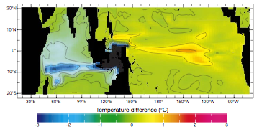
Prior Studies
Cane & Molnar (2001)
Ocean-only model
Jochum et al (2009)
Coupled Model
Reduction in total Indonesian Throughflow
Some changes in source water to Southern Hemisphere
Only found SST changes of <0.3ºC in Pacific
Changes in ENSO statistics

Slide 17
Impact on Trop. Pac.

Slide 18
C) Isthmus of Panama
Central American Seaway slowly constricted during Miocene
No flow between Atlantic & Pacific sometime in Pliocene
Proposed as trigger for glacial cycles at 2.7Ma, but now thought to have shut earlier
Tested in a variety of models
I’ve removed Panama to a depth of 1km, so a very strong perturbation
Kirby et al. (2008), PLoS One

Slide 19
Shutdown of AMOC
The Atlantic Meridional Overturning Circulation (AMOC) is has sinking in North Atlantic to ~1.5km and then flowing southward
Depends on salinity difference between N Atl. and N Pac. which is driven by flow of atmospheric water over Panama to Pac.
Allowing ocean return flow in Northern hemisphere kills the AMOC
Figure after 1000 yrs of simulation rather than 500 yrs

Slide 20
Impact on Trop. Pac.

Slide 21
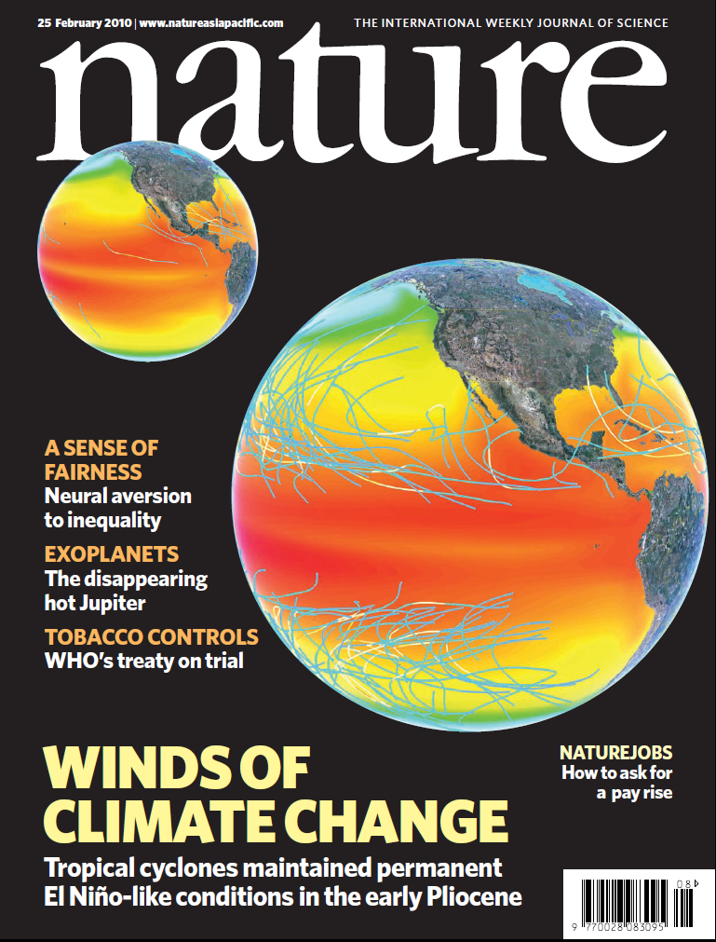
D) Tropical Cyclones
When we created reconstruction of vast warm pool, we suggested that an increase in ocean vertical mixing would deepen thermocline and lead to reduced SST gradients
Later suggested this mixing may be from tropical cyclones (a.k.a. hurricanes)

Slide 22
Synthetic Tracks
Modern
Pliocene

Slide 23
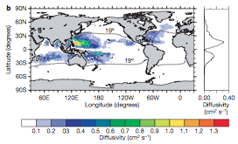
Model hurricanes
Observations indicate hurricanes give vertical mixing up to 1cm²s⁻¹ (Sriver & Huber, 2007)
As first order, include 2 broad stripes of mixing in upper ocean (Fedorov et al. 2010)

Slide 24
Impact on Trop. Pac.

Slide 25
e) Cloud Properties
Cloud properties and feedbacks are the largest cause of uncertainty in climate projections
Their properties are influenced by the amount of aerosols in the air (called aerosol indirect effects)
The aerosols are not well constrained in the past and could change with land surface and ocean conditions
IPCC fig 10.11a). Global mean cloud radiative forcing from coupled models under A1B scenario – not even the sign is certain

Slide 26
cloud Albedo
Barreiro & Philander (2008) use a simple climate model to test sensitivity of climate to reduction in cloud albedo in extratropics
Find a weakening of equatorial SST gradient
Their method is not applicable in a more complex model like CESM, so I reduce the cloud liquid water to 80% polewards of 35ºN/S in the shortwave radiation code

Slide 27
Impact on Trop. Pac.

Slide 28
Comparison
Looking for:
Reduction in equatorial SST gradient of ~4ºC
No warming in West Pacific
Reduction in meridional gradient in both hemispheres
No single pattern does this

Slide 29
Combination
Obs.
CESM
If none of the hypotheses explain the pattern individually, perhaps they all combine together
Ran for 200 yrs from end of Panama simulation, but skipped Indonesian changes
There is some improvement in the model simulations (right), but it certainly does not reach the flatness of the reconstruction (left)
Now
4Ma

Slide 30
Summary
There is no silver bullet to explain the vast warm pool of the Early Pliocene among the hypotheses already out there
A combination of all the hypotheses approaches the reconstruction, but most of the impacts are pushing the envelope
We may need another explanation – be it a new climate mechanism, new forcing or reintepretation of the paleo-observations: any suggestions?

