Slide 1
Better climate predictions using hindsight
Chris Brierley
Acknowledgements: Alexey Fedorov (Yale), Mat Collins (Exeter, UK),
Alan Thorpe (NERC, UK), Tim Herbert (Brown), Christina Ravelo (UCSC),
Peter deMenocal (LDEO), Kerry Emanuel (MIT)
Funded by NERC, National Science Foundation, US Dept. of Energy
Notes:
Don’t move too much. Name check some people (don’t just list or pass over)

Slide 2
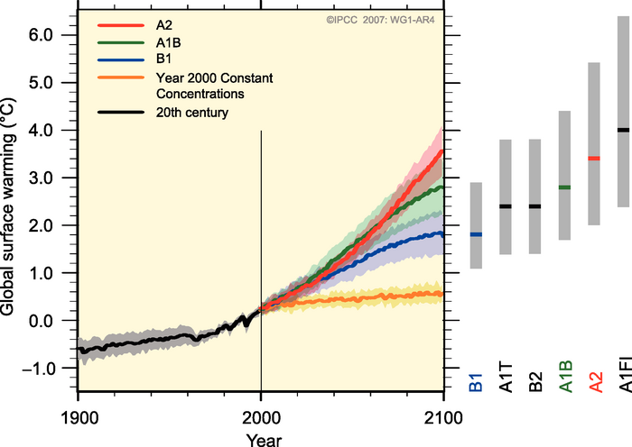
An Example Climate Prediction
From the Summary for Policymakers of the IPCC’s 4th Report
Three scenarios giving 2-3.5ºC warming by end of the century
Indication of spread means uncertainty exists in prediction
Notes:
Summarizing sentence instead of IPCC book

Slide 3
Uncertainty
Uncertainty from
initial conditions
scenario
climate models
Range of different models is as large mean warming for each scenario (shown by bars at right)
IPCC AR4, SPM
Notes:
Split into 2 slides

Slide 4
Model Uncertainty
Climate models have a finite grid resolution (~100mi)
There are processes that occur on scales smaller than this, such as clouds and hurricanes
We can include these processes through parametrizations
Model uncertainty further sub-divided
Imperfect inclusion of known processes (poor parameters)
Imperfect knowledge of climate system (not parametrized)
By understanding the Earth’s response to previous drivers, we can gain improved understanding of the climate system
Notes:
Split into 2 slides

Slide 5
Joining paleodata & predictions
Paleo-obs
Paleo-modeling
Climate Model
Predictions
Paleodata
Model
Synthesis & Simulation
Insight
Improved Model
Better Predictions
Notes:
New Title

Slide 6
Pliocene Hurricanes Outline
Introducing the Early Pliocene (Paleodata)
Sea surface temperature reconstruction (Synthesis…)
Modeled Pliocene climate (…and simulation)
Comparison to future projections
Tropical cyclones (Insight)
A new climate feedback
Conclusions

Slide 7
Pliocene Warm Period
5-3 million years ago
Continental configuration roughly the same
Incoming solar radiation can be treated as the same
Small carbon dioxide increase
Collaborative Review, in prep.
Notes:
Describe the axes

Slide 8
Synthesis & Simulation
Brierley et al. (2009), Science, Vol. 323., no. 5922, pp. 1714 - 1718
Combined paleo-observation and climate modeling study
Focused on the behavior of the tropical Pacific

Slide 9
Permanent El Niño-like state
Sea surface temperature gradient along the equatorial Pacific was much smaller in early Pliocene
Mean climate similar to the warm phase of ENSO (El Niño)
Wara et al., Science. 2005
Notes:
Add some text

Slide 10
California Margin
North-South temperature gradient in eastern Pacific much smaller in early Pliocene
Brierley et al., Science. 2009

Slide 11
Reconstruction: a vast warm pool
Sea Surface Temperature (ºC)
Sea Surface Temperature (ºC)

Slide 12
Climate Impacts
Use reconstruction underneath atmospheric model
Analyse important aspects of simulated climate
Test sensitivity of state to find possible underlying causes

Slide 13
Tropical Circulations
Upper level divergence
Walker Circ.
Convection,
uplift & clouds
Hadley Circ.
Notes:
Add some words

Slide 14
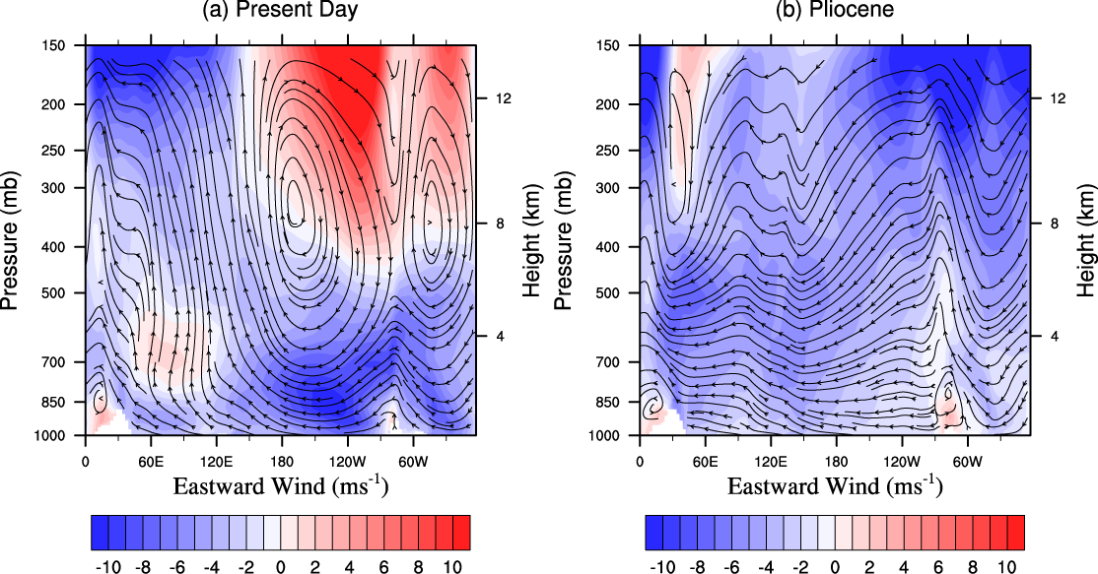
Walker Circulation Collapses
Walker Circ.
Notes:
Perhaps put previous Walker Cell plot before showing Pliocene. Label Pacific. Reference

Slide 15
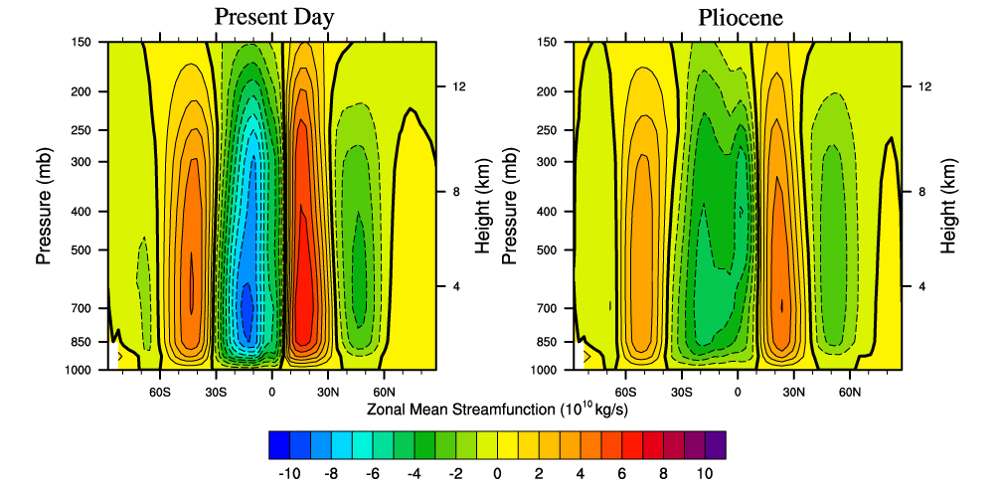
Hadley Circulation Weakens
Hadley Circ.
Notes:
Mention Ferrell Cell and lack of data

Slide 16
Early Pliocene Summary
Early Pliocene boundary conditions similar to today (with its elevated greenhouse gas levels)
Vast pool of warm water in the tropical Pacific
Sluggish atmospheric circulation

Slide 17
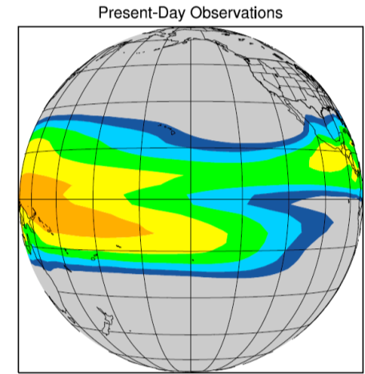
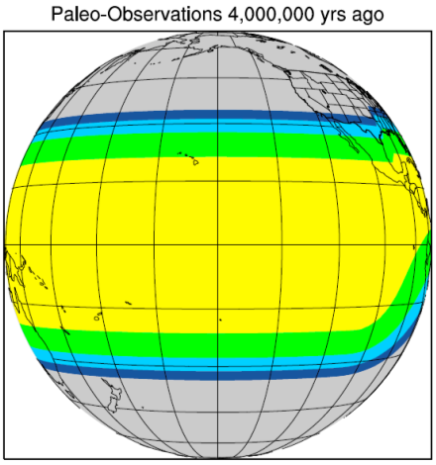
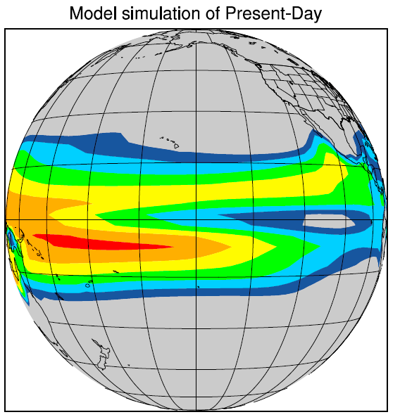
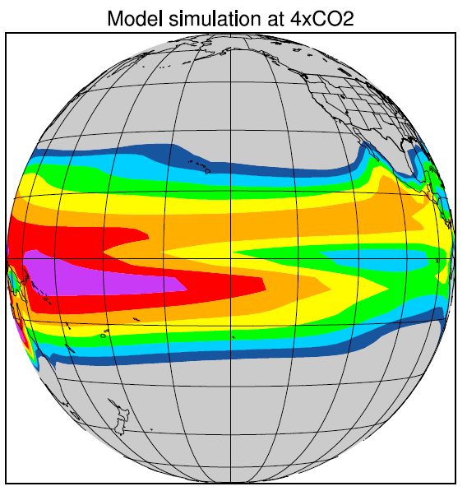
A lesson from the past?
Pliocene warm pool unlike predicted response to added CO₂
Are coupled climate models unrepresentative of the Earth system
Past Lesson
CO₂
Model Future
CO₂

Slide 18
Reconciling the past and future
If modeled response differs from observed response of the earth system, then there must be an error somewhere:
Paleo-observations are wrong or misinterpreted
Missing forcing (Pliocene is poor analog)
Important physics missing in climate models

Slide 19
Insight

Slide 20
Tropical Cyclone Basics
Some of most deadly natural disasters
Roughly 90 storms occur every year
Strong winds on scales smaller than GCMs
Feed on energy extracted from the ocean
Strongly mix upper ocean
Bonnie’s cold wake from Reanalysis data.
Sriver & Huber Nature (2007)

Slide 21
Future behavior of hurricanes
Known to be controlled by SSTs and vertical wind shear among other things
Future behavior still uncertain as residual between SST and wind shear increases (at least over N. Atl.)
IPCC AR4 says
>66% chance increase in peak wind and rain intensity
~50% chance decrease in frequency, with regional variations
Pliocene was both warmer with weaker wind shear

Slide 22
Statistical Downscaling Model
Create realization of large scale atmospheric flow
Embed a little storm and use hurricane track prediction model to work out where it would go
Use 2D CHIPS model to determine intensity along track
Repeat until have at least 10,000 synthetic tropical cyclones
Most tracks don’t even reach tropical depression status

Slide 23
Synthetic Tracks for Present-day
MODERN RECONSTRUCTION
2 Years
20 Years
Tracks of tropical cyclones, 1985-2005 (Wikipedia)
Notes:
Much less storms on top panel as only 10th of the length.

Slide 24
Synthetic Hurricane Tracks
MODERN RECONSTRUCTION
2 Years
PLIOCENE RECONSTRUCTION
2 Years
Fedorov, Brierley & Emanuel, 2010
Notes:
Reproduces the modern hurricane distribution quite well. Some problems in the Atlantic, but we will concentrate on the Pacific. Add number of storms?

Slide 25
Power Dissipation Index
Defined by Emanuel (2005) as
Increasing in recent years in the N. Atlantic
Related to turbulent mixing in the ocean
Useful diagnostic to look at spatial distribution of TCs
Emanuel, Nature, 2005
Notes:
Reference.

Slide 26
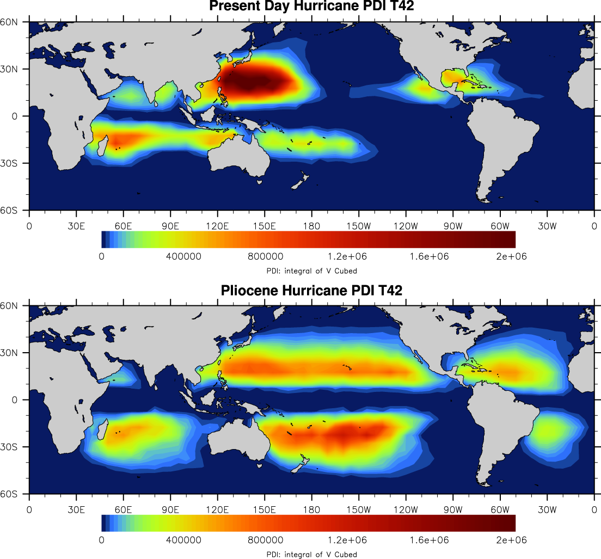
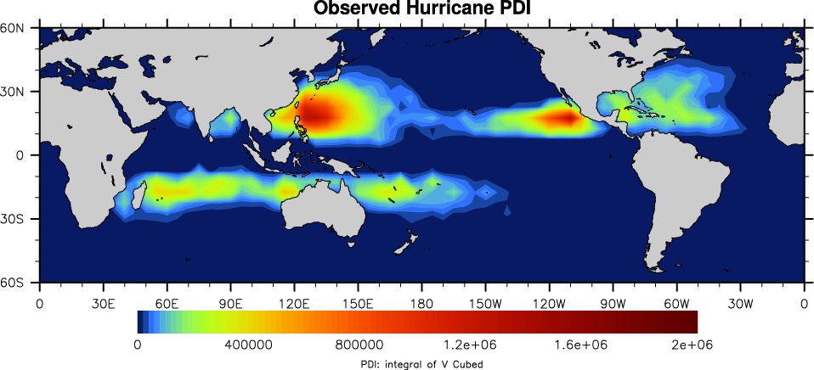
PDI Patterns
Present day pattern similar to observations
Pliocene causes mixing in broad bands across the Pacific

Slide 27
Wind-driven Subtropical Cell
Water is subducted in subtropical East Pacific
Travels west towards warm pool
Catches undercurrent & upwells in east
Gu & Philander, 1997
Notes:
Wind-driven, by mean atmospheric winds

Slide 28
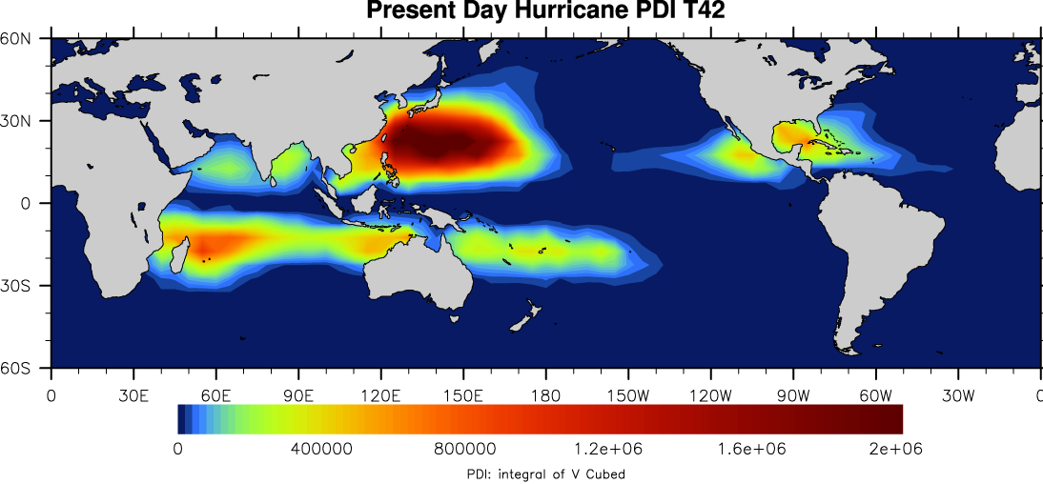
Present-Day Subduction Pathways

Slide 29
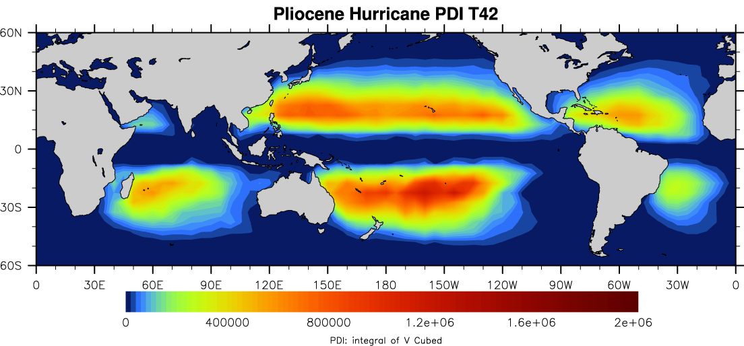
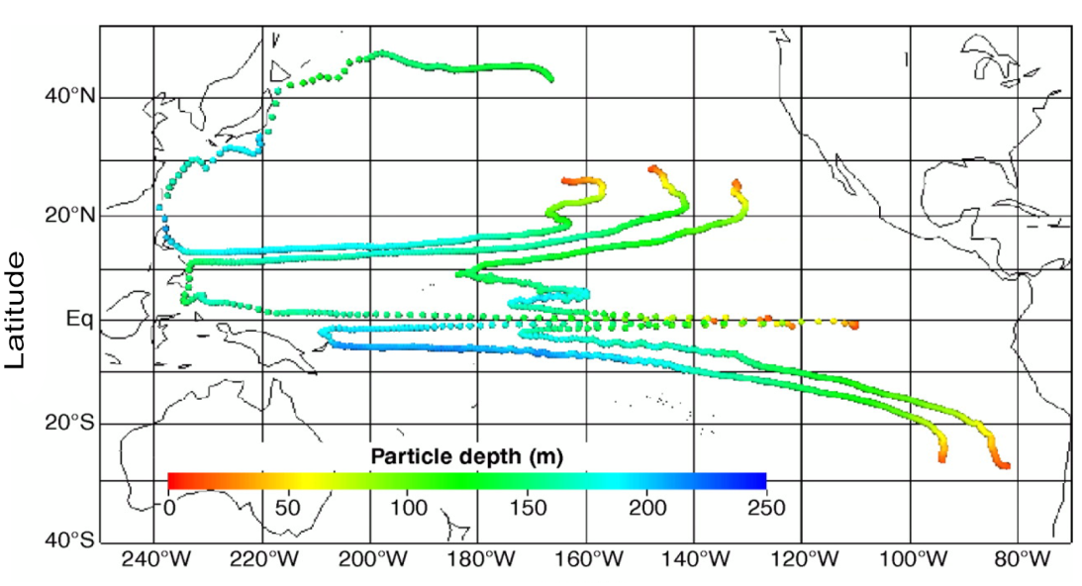
Pliocene Subduction Pathways

Slide 30
Hurricane Mixing
Inclusion of tropical cyclone mixing leads to a significant warming of east equatorial Pacific
Implies hurricanes may play role in climate system – not currently incorporated in models
Warm pool does not expand towards the poles

Slide 31
El Niño and Hurricanes
Warming of the cold tongue leads to:
Formation of more storms in central and eastern Pacific
More storms passing over subtropical overturning cell
El Niño (~1yr) is much shorter than STC (~20yrs) so would not expect any impact on east equatorial Pacific
Genesis density (storms formed per 2.5º x 2.5º)
Track density (storms per 2.5º x 2.5º)
Camargo et al., 2007

Slide 32
Summary
Predictions of future climate have uncertainty
Some of this uncertainty comes from phenomena not included in climate models
Paleoclimate modeling leads to insights about the missing phenomena (such as my discovery of hurricane feedback)
Increased Storms
Warming of East Pacific
Increased Mixing on Pathways

Slide 33
Questions Arising – part I
What model/climate physics are needed to create a vast warm pool?
How well are they constrained in the modern climate?
Could they change in the future or past?
CO2 Changes
-2 0 2
Hurricane Mixing
-2 0 2
Central America Tectonics
-2 0 2

Slide 34
Questions Arising – part II
What will hurricanes do in the future?
What are the climate impacts of hurricanes?
How do we incorporate those impacts on climate models?
Hurricane Mixing
Manucharyan, Brierley & Fedorov, in prep.
Hurricane Winds
Sriver & Huber, 2010, GRL

Slide 35
Chris Brierley
Research Goal
Better
climate predictions
Methods
Bridging paleoscience and models to increase understanding of the Earth system
Uncertainty analysis to create probabilistic predictions
Results
Greater understanding of Pliocene warm period
Discovery of hurricane feedback
Ocean parameters’ contribution to model uncertainty
Better climate predictions

Slide 36
Tropical Cyclone Feedback
Increased Storms
Warming of East Pacific
Increased Mixing on Pathways

Slide 37
Improving climate predictions by learning from the past
Paleo-observations
Paleo-modeling
Climate Model
Predictions
Initial data
Initial Model
Synthesis & Simulation
Uncertainty Analysis
Insight
Improved observations
Improved Model
Better Predictions
Notes:
Make this more general. Bridging between palaeoclimate and climate prediction/climate model. Maybe labeling columns. A RESEARCH OUTLINE HERE INSTEAD

Slide 38
A. What is a permanent El Niño?
Either
lack of SST gradient in mean state
lack of variability
How are these two properties linked?
Use multi-model ensembles, then an idealized model to investigate relationship

Slide 39
Model Uncertainty
Investigated amount of uncertainty attributable to uncertain ocean parameters
Work led to several papers and was important step in creation of UKCP probabilistic climate forecast for Britain (first in world).
Accurate forecasts essential for adaptation to climate threat
Notes:
GO OVER THIS SLIDE QUICKLY

Slide 40
East/West or North/South?
E/W and N/S tropical SST gradients have different temporal behavior
Looked at importance for onset of glaciation
Suggested E/W SSTs important for tropical precipitation
Onset NHG

Slide 41
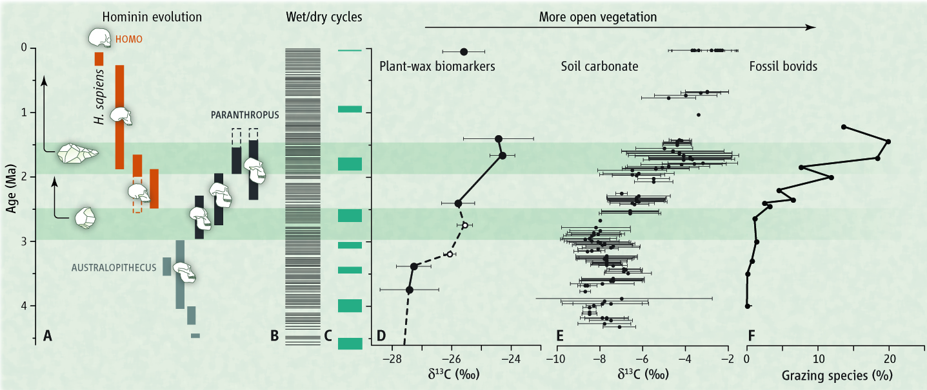
East African Rainfall Impacts
deMenocal, 2011
deMenocal et al., in prep.

Slide 42
LGM Hurricanes
Predictions of future hurricane behavior are highly uncertain
Use paleohurricane technique to look at other past climates to determine important climate properties
Apply findings to AR4 multi-model projections

Slide 43
Future Hurricanes
Predictions of future hurricane behavior are highly uncertain
Use paleohurricane technique to look at other past climates to determine important climate properties
Apply findings to AR4 multi-model projections
Vecchi & Soden, 2008, EoS

Slide 44
Without Paleomodelling
Paleo-observations
Climate Model
Predictions
Initial data
Initial Model
Improved observations
Improved Model
Better Predictions
Notes:
Make this more general. Bridging between palaeoclimate and climate prediction/climate model. Maybe labeling columns.

Slide 45
Uncertainty Analysis
Paleo-observations
Paleo-modeling
Climate Model
Predictions
Initial data
Initial Model
Synthesis & Simulation
Uncertainty Analysis
Insight
Improved observations
Improved Model
Better Predictions
Notes:
Make this more general. Bridging between palaeoclimate and climate prediction/climate model. Maybe labeling columns.

Slide 46
Summary – Pliocene Hurricanes
Paleo-observations
Paleo-modeling
Climate Model
Predictions
Initial data
Initial Model
Synthesis & Simulation
Insight
Improved observations
Improved Model
Better Predictions
Notes:
Make this more general. Bridging between palaeoclimate and climate prediction/climate model. Maybe labeling columns. ALEXEY DISLIKED FLOW CHART HERE – HAVE TAKE HOME MESSAGE

Slide 47
Any Questions ?
Career
Publications
Associate Research Scientist (Yale)
Post-Doc (Yale)
PhD in Meteorology (Reading)
BSc in Physics (Durham)
C. M. Brierley, A. V. Fedorov (2010), The relative importance of meridional and zonal SST gradients for the onset of the ice ages and pliocene-pleistocene climate evolution, Paleoceanogr., 25, PA2214
A. V. Fedorov, C. M. Brierley and K. Emanuel (2010), Tropical cyclones and the climate of the Early Pliocene, Nature, 463, 1066
C. M. Brierley, M. Collins and A. J. Thorpe (2010), Spatial patterns of ocean model uncertainty in projections of preindustrial climate and climate change, Clim. Dynam., 34, 325
C. M. Brierley, A. V. Fedorov, Z. Lui, T. D. Herbert, K. D. Lawrence and J. LaRiviere (2009), Reduced meridional temperature gradient and weak Hadley circulation in the early Pliocene. Science, 323, 1714
C. M. Brierley, A. J. Thorpe and M. Collins (2009), An example of the dependence of the transient climate response on the temperature of the modeled climate state, Atmos. Sci. Lett., 10, 23
M. Collins, C. M. Brierley, M. MacVean, B. B. B. Booth and G. R. Harris (2007), The sensitivity of the rate of transient climate change to ocean physics perturbations, J. Clim., 20, 2315
J. Ridley, J. Lowe, C. M. Brierley and G. Harris (2007), Uncertainty in the sensitivity of Arctic sea ice to global warming in a perturbed parameter climate model ensemble, Geophys. Res. Lett., 34, L19704
Notes:
Final CV slide. Perhaps outline again.

