Slide 1
Tips for fellowship applications
Kristina Harrison
Medical Research Council (UKRI)
Programme Manager for studentships

Slide 2
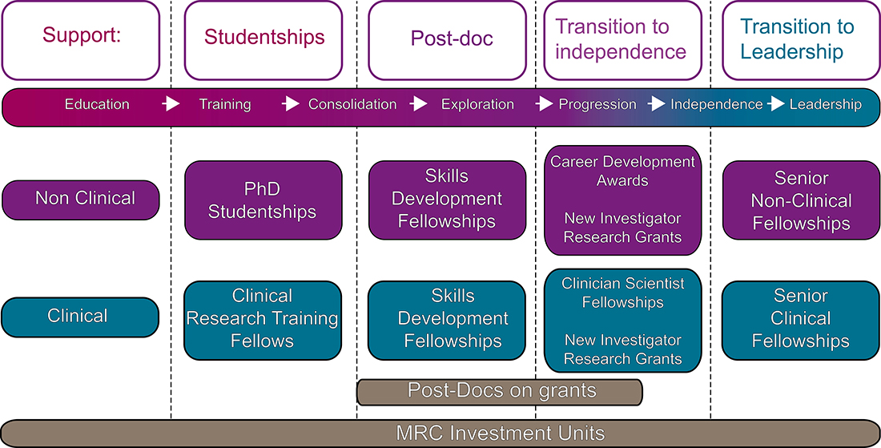
MRC supporting key career stages

Slide 3
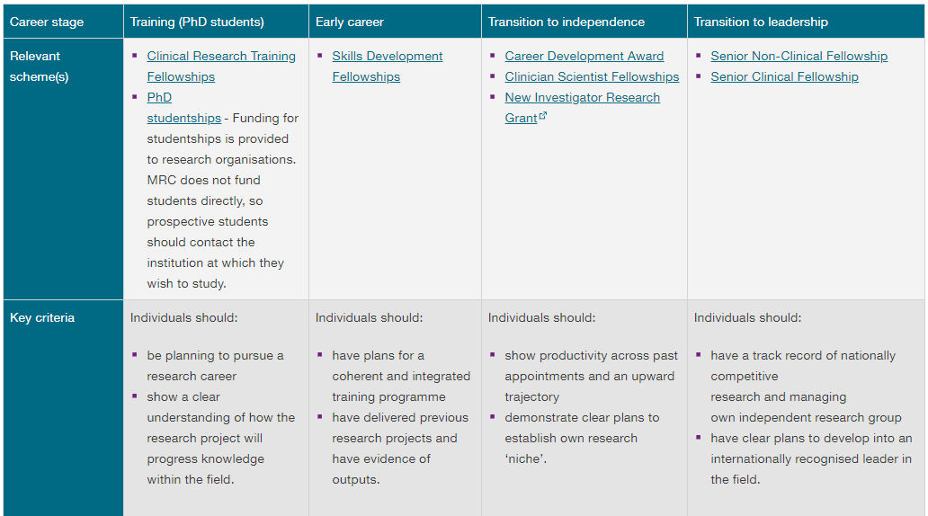
Skills needed to win support

Slide 4
Tips for application writing

Slide 5

Right idea? Right funder?
Get involved in grant writing, even as observer
Create a collaborative network
Be on top of the literature (but not buried by it)
Identify the funder’s remit & priorities – if in doubt, ask early!
Consider suitability criteria
Submission deadlines
Start early – everything takes longer than you think!
Notes:
See 12 top tips for writing a grant application http://www.insight.mrc.ac.uk/2015/10/05/12-top-tips-for-writing-a-grant-application/

Slide 6
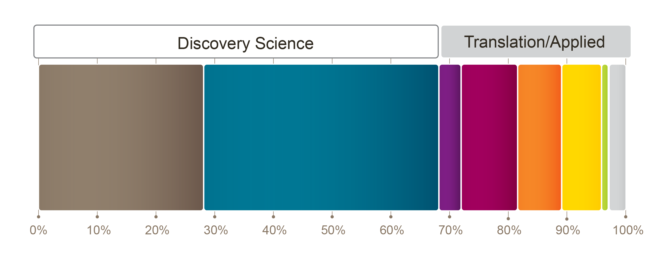
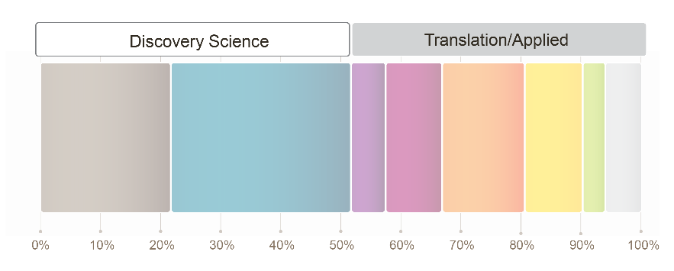








Discovery science and applied research portfolio
MRC 5 year Average 13/14 – 17/18
Public Sector and
Research Charity 2014
Underpinning
Prevention of Disease and Conditions,
and Promotion of Well-Being
Development of Treatments and Therapeutic Interventions
Management of Diseases and Conditions
Mechanisms of Disease (aetiology)
Detection, Screening and Diagnosis
Evaluations of Treatments and
Therapeutic Interventions
Health and Social Care Services Research

Slide 7
Making a successful application
Top tips
Don’t be boring (“So what?”)
Be ambitious, original and credible
Structure a clear, logical plan to achieve challenging objectives
Explain pilot data & others’ inputs
Risks are inevitable: Have a Plan B
Write clearly, for experts & non-experts in your field
Invite tough criticism from peers, mentors & friends before you submit

Slide 8
Justification of resources
To aid reviewers in assessing your proposal – resources requested appropriate for the research proposed?
Ensure you are aware of fellowship guidance regarding any limits or restrictions associated with costs
Provide adequate details, not simply a list!
Requests should be reasonable and explained fully
Remember you will be not be the only fellow under consideration

Slide 9
Lay summary
Summary of the entire proposal – write it last!
Understandable by researchers outside the field
Ask non-experts to review (colleague, friend, family member)
Will be the first thing read by primary reviewers
May be the ONLY thing read by other committee members (but not at MRC of course)
Will influence the way reviewers approach the rest of the proposal

Slide 10
The 3 Ps – Person, Project and Place
The applicant’s potential
  Will be dependent on the scheme
  Career aspirations and how the fellowship will support this
The project
  Originality and importance of question being addressed
  Appropriately ambitious and include suitable development opportunities
The place
  Appropriateness of institute will be considered
  All schemes offer the opportunity to undertake a period of research training overseas, in industry or 2nd centre

Slide 11
Application processes
Complete application form
  Read guidance for application (and ask!)
  Case for support
  Cost application (in conjunction with RO)
  Obtain approvals/letters of support
Own Research Organisation approval
  Submit application to RO for final costing/approval
Application submission
  Research office may need a couple of days to do this – build in time!
Application process
  A number of different people will review
Notes:
11

Slide 12
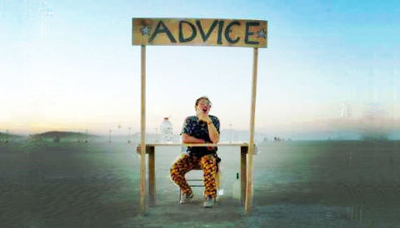
Sources of advice
Funder
  Website, helpline
  Named contact
University Grants office
  University requirements
  Costing software
  Assistance in preparing grant applications
    Writing workshops
    Helpdesk
Experienced colleagues and collaborators
  Past evaluation committee members
  Successful grant applicants
12
Notes:
Medical Research Council
November 15, 2018 12
Sample text for footer

Slide 13


More information
www.mrc.ukri.org
fellows@mrc.ukri.org
Notes:
More info on our website

