Slide 1
DWP Analytical Community
PhD Placement offer

Slide 2
The five W’s + 1
What is it?
A placement within the DWP Analytical Community, lasting up to three months, full time. Projects are directly linked to our Areas of Research Interest and Evidence Questions.
Who is it for?
Any funded PhD student in their second or later year.
Where is it?
Students will be attached to one of our main hubs: Glasgow, Newcastle, Manchester, Sheffield, Leeds, London or Treforest although remote working and other options may be available.

Slide 3
The five W’s + 1
When is it?
We advertise the placements in September through, UPEN, the Methods Advisory Group, Handshake, ARI contacts and other networks. Students will join us throughout the following year from March onwards.
Why do we do it?
We can learn from each other, make long term connections and collaborate. Students make a huge impact during their time with us.
Why would you do it?
Access data you can’t get anywhere else, Influence policy, Build networks, Present your work and Make a difference

Slide 4
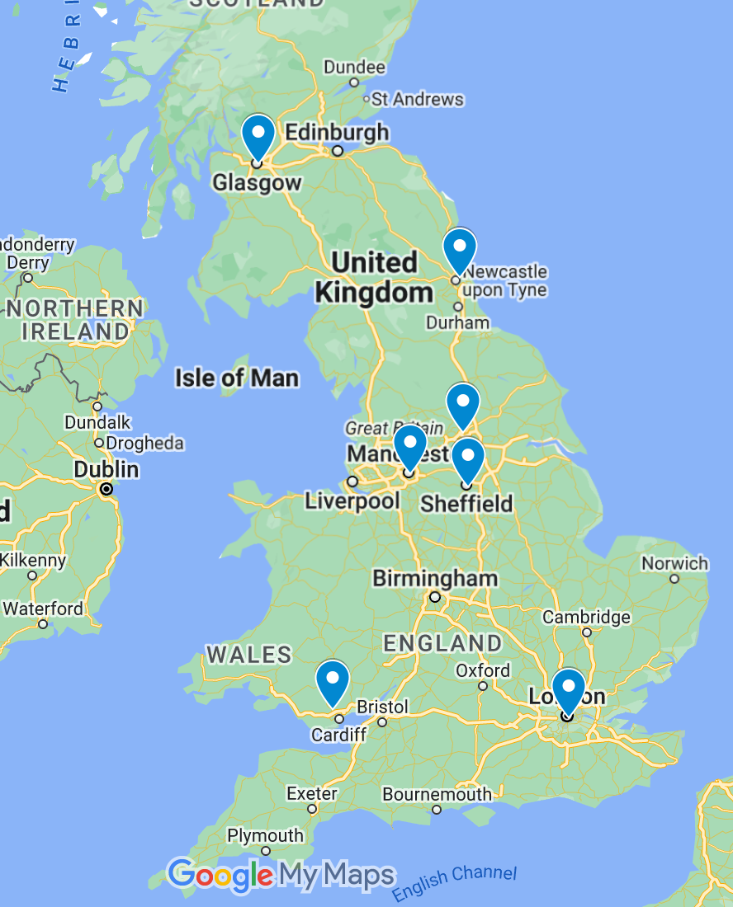
Where are we?
There are DWP Hubs in
Glasgow
Newcastle
Manchester
Sheffield
Leeds
London
Treforest

Slide 5
DWP Analysts in Numbers
20 Lead Analyst Areas
80+ Individual Teams
700+ Analysts

Slide 6
Examples of past projects
Literature Review of the drivers of health and life expectancy changes.
(Pensions & Later Life Analysis)
The impact of Admin Penalties on repeat overpayments: helping assess the impacts of penalties on reducing benefit fraud.
(Fraud Error and Debt Analysis)
Understanding the experience of separated and separating families over time.
(Income, Families and Disadvantage Analysis)
Work Coach approaches to tailoring conditionality.
(Universal Credit Analysis Division)
Exploratory analysis of the spending patterns of people receiving disability benefits
(Disability Analysis Division)
Positioning parental conflict and relationship support within the landscape of local services for families and children
(Income, Families and Disadvantage Analysis)

Slide 7
Case Study 1 - Verity
Background
Outcome
Verity joined us from the University of Leeds School of Geography.
Her PhD Title was Understanding Crime Generators, Attractors and Enablers: a Natural Experiment in Harm Prevention
She worked in the Financial Modelling and Analysis Team and completed a project on Distance to Work - The Department had a long-standing need to improve the capability of mapping and modelling where our staff and claimants live in relation to our offices. Having this capability allowed us to fully understand the impacts and costs associated with changing our estate. The project involved understanding user needs for a travel time solution, a literature review of available technologies and approaches and then acquiring or building a solution using data science techniques.
Her experience with DWP helped her prepare for a successful application and interview with the Government Operational Research Service
I really enjoyed my secondment - I think it was a really beneficial thing to have done. I went to work in the charity sector following my PhD, and my interviewers commented specifically on that secondment as part of the reason they gave me the role.

Slide 8
Case Study 2 - Sarah
Background
Outcome
Sarah joined us from the University of Leeds, where she was doing a PhD on ‘Utilising longitudinal analysis methods to capture spatio-temporal variation in geographical data.’
Applied because she was unsure about whether to continue in academia after her PhD and hadn’t worked outside universities before so wanted the chance to see what the working environment was like.
Joining working in our Data Science team, the project outline was ‘Looking at progress of claimants through different parts of the universal credit service,’ with flexibility to plan the project and define its scope with help from members of the team. This created a great opportunity to get to grips with the realities of modelling, which is often less straightforward with real data and scenarios.
Also became involved in some of the team’s work as part of the pandemic response.
The team were welcoming, friendly and encouraging. Made to feel she was a part of a team, helped to develop her confidence at work and learning to cope with big shifts in priorities and balancing different pieces of work.
I had a nice enough time that I came back to work for DWP after my doctorate, in the UC data science team where I’m now a senior data scientist. I’ve had a similarly positive experience with colleagues in this team.
Sometimes things can be quite fast paced, and priorities can change quickly, but I’m supported in maintaining a proper work-life balance. While I knew I wouldn’t be doing the same kind of methodological work as in my thesis, I’ve been surprised at how often I’ve used knowledge I learned during my PhD in my job.

Slide 9
Case Study 3 - Ceri
Background
Outcome
Ceri joined us in 2021 whilst doing her PhD in Social Policy, part-time with London School of Economics and Political Science.
She worked in our Labour Market Analysis Division on a Theory of Change project. Gaining exposure to the research process, as well as using different methods to engage with claimants, and considering how we capture that robustly.
Her experience of gathering insights from the surveys was hugely relevant when considering alternative methods of data gathering.
Although Ceri didn’t come back to join us permanently, she has continued to collaborate with us - working with the department and engaging with us through ARI events – including giving a spotlight talk on ‘Single Mother Employment and the COVID-19 Pandemic’ at an event held at MMU in 2022. Which is another great example of the longer-term benefits of the scheme.

Slide 10
Examples of other projects
Any Questions?
Contact us: EVIDENCE.STRATEGYTEAM@DWP.GOV.UK

