Slide 1
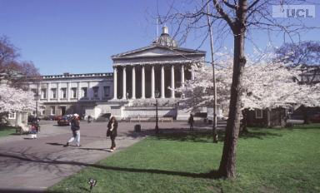
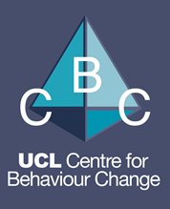
Reflections on my career and why it has developed as it has
Susan Michie
Professor of Health Psychology, UCL
UCL, June 2017

Slide 2
Zigzagging
Education/training – 8 years
NHS Hospital – about 10 years – had 3 children
Kings College London + 1 day at NHS Hospital – 9 years
University College London – 15 years

Slide 3
Education/training
Undergraduate – Experimental Psychology
Clinical Psychology training
PhD in Developmental Psychology

Slide 4
Royal Free Hospital
Worked as clinical psychologist for children and families
Began to do research into antenatal care
Clinical/academic post
clinical post in Occupational Health Unit
organisational consultancy
research into organisational interventions and staff stress

Slide 5
University posts
Kings College London
Research programme investigating psychological aspects of genetic testing
One day a week at Royal Free Hospital
Chair of the British Psychological Society Division of Health Psychology
University College London
Behaviour change in relation to health
Prevention, adaptation to illness, implementation (professional practice)
President of the European Health Psychology Society
Consultancy with the Department of Health; with NICE (National Institute for Health and Clinical Excellence
Set up UCL Centre for Behaviour Change

Slide 6
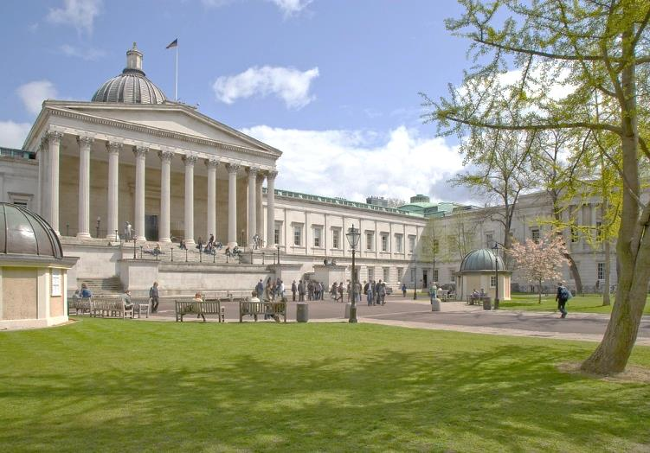
UCL Centre for Behaviour Change
@UCLBehaveChange www.ucl.ac.uk/behaviour-change

Slide 7
What has influenced what I have done?
In my inaugural talk when I was made a professor, I thanked my parents who taught me to
Question everything
Respect evidence
Value social justice

Slide 8
The work that I have done …
Intellectually interesting
Socially useful
Working with people who I like

Slide 9
This has led to working with …
Many disciplines across a broad range
E.g. Human Behaviour Change Project
Policy-makers
E.g. Dept Health, Public Health England
… both require listening and understanding agendas, incentives, concepts, language
… this takes time

Slide 10
Some tensions
Work vs Rest of life
Work is only one part of one’s life – but an important part!
Academic vs applied
Clinical, policy
Breadth vs depth
Be curious and open to opportunities vs be focused
Ploughing one’s own furrow vs helping others/being collegiate
Altruism is reciprocated

Slide 11
Some Top Tips
Follow your energy and enthusiasm
Make things fun
Be organised
That way you can lead at least two lives in one
Persistence pays
If you believe in something or want something, don’t give up & don’t put practicalities before possibilities
Never be afraid to say you don’t know or ask for help
Seek and use mentorship/ support/ help
And offer it!

Slide 12
For research …
Know what’s gone before
Understand the history, what has been done, why, with what outcomes; what has been found and learnt?
Science is/should be a cumulative process
Be prepared to go out on a limb
don’t be constrained by current thinking/fashion
Communicate clearly
K.I.S.

Slide 13
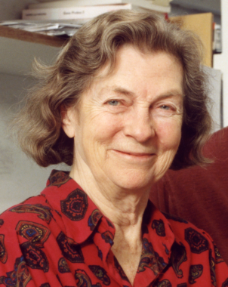
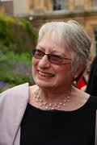
Three women who are great scientists, mentors and role models
Anne McLaren
My mother, a great role model for working mothers
Marie Johnston
A health psychologist with big visions and a keen eye for supporting others’ careers
Uta Frith
Endless enthusiasm for supporting women scientists, creating networks and discussions

