Slide 1
Intellectual Property and Commercialisation
UCL Institute of Women’s Health
19th September 2019
Caitriona O’Rourke
  Associate Business Manager, UCL Business

Slide 2
Commercialisation of Translational Research
Part 1
An Introduction to UCL Business Ltd
Part 2
Intellectual Property Rights and commercialisation
Patents
Part 3
UCLB case studies
Common success criteria
What to take away

Slide 3
Commercialisation of Translational Research
Part 1
An Introduction to UCL Business Ltd
Part 2
Intellectual Property Rights and commercialisation
Patents
Part 3
UCLB case studies
Common success criteria
What to take away

Slide 4
We help support and commercialise research from UCL and NHS trusts associated with UCL
Who we are
Our services
We are a wholly owned subsidiary of UCL
25 years of experience
50 employees
Distribute over £3.5m per year to UCL and investors
Strong board with extensive industry experience
We provide technology transfer services:
Intellectual property (IP) protection
Patent registration
Support for the creation of new businesses
UCLB
Who we work with
UCL
UCLH
Moorfields Eye Hospital
Royal Free Hospital
GOSH

Slide 5
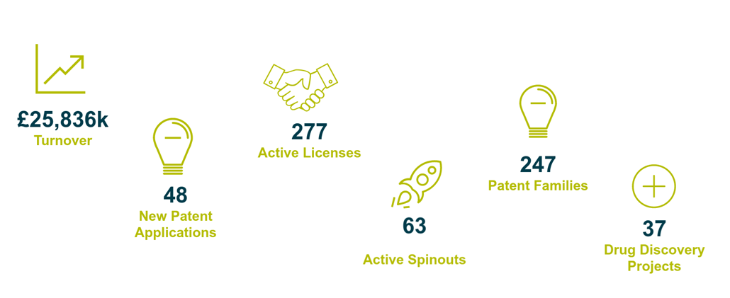
Bringing Innovation to life

Slide 6
Commercialisation of Translational Research
Part 1
An Introduction to UCL Business Ltd
Part 2
Intellectual Property Rights and commercialisation
Patents
Part 3
UCLB case studies
Common success criteria
What to take away

Slide 7




Intellectual property and commercialisation
Funder require UCL to protect and exploit Project IP, especially translational funding
Maximising Research Impact
Leverage IP for Translational Funding
Maximise dissemination of UCL research
Create Impact: Societal, Economic and Health
.
NIHR, MRC, Wellcome Trust, CRUK
.
Most Universities have a Technology Transfer Office
Attract others Funding Sources
Venture Capital Funding
  Imperial Innovations,
  Cambridge Enterprise,
  Oxford University Innovation,
  UCLB
Notes:
Why is intellectual property and commercialisation important?
Obviously there are different aspects, especially depending on the industry or the circumstances.
So if you have your own spin-out, maybe even self funded it is your existence that is on the line and you obviously want to ensure that your technology is protected that no ones can copy you but also to actually make money out of this protected technology as without any development and commercial sales at the end the best technology is not much worth
From an University perspective the incentives are similar
To get public funding is getting more and more difficult
Funding is decreasing
Research is expensive and has to be recovered
As such IP protection and commercialisation is really helpful to leverage and attract more funding
While nature and other publication obviously help to disseminate research findings and always will be at the core of all universities, commercialised technologies help to further disseminate UCL research
Creates direct and measurable impact which gets more and more effective such as REF etc.
Its one point to say that you had 100 nature paper and so on but if you can also state that the same amount not only has given you the same amount of nature paper, but also that it has helped to attract several millions of further funding i.e. VC funding and that it has provided the basis of x clinical trials and that the technology actually will be brought to the market and will cure patients of a specific diseas that is real and clear Impact.
But with the commercialisation not only helpos to generate more grant income it actually helps to generate additional money for the unviersirty or at least this has to be the aim
So its not surprising that all major universities have TTO’s especially that considering that more and more funder actually expect or demand to have this

Slide 8
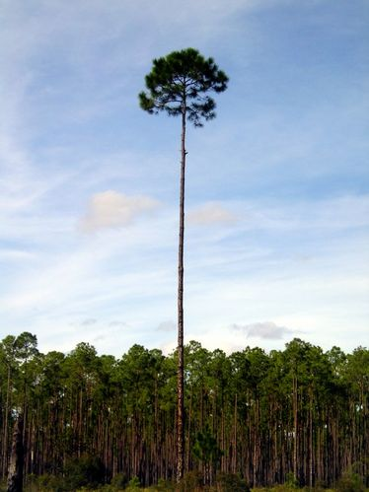





Maximising Research Impact
Biomarker
Therapeutic
Device
Software
Agreements
Intellectual Property Protection
Post Signature
Management
Active
Marketing
Project
Evaluation
Project
Development
Notes:
So how do we help the university and the researchers
Well at the beginning its always the researcher with an idea or a new technology, and generally I have the attitude please contact me as early as possible. Its easy to say lets meet again when you have done this or this compared to well that is really interesting but you should have contacted me earlier. That also counts for your ideas outside of University
Ask for help, you will be surprised how many people are willing to provide you with help free of charge. Not saying go and tell everyone your idea, always protect your idea and be careful whom you tell what. But what I mean is, if you have questions on regulatory pathways ask the MHRA and I have to say contrary to many believes they are really helpful and you also can get load for free. Be aware of accelerator programes, even if you not win often they have training sessions and workshops as part of the competition that can open so many other doors.
So in a short summary we want to support the academics to get from the idea to a fully grown product.
Project development – grant funding is OK but also wanted to have a more concentrated translational focus to really accelerate. TRO – translational office really helpful but even expertise doesn’t really help if there is no money to accelerate. We have two funds
UTF – 50m PoC and licensing and spino out –really flexible to suit different projects
Apollo – JJ, AZ and GSK, Imperial Cambridge and UCL – be an external developent platform for the companies to develop and they have then first right of refusal and if not interested we can go off and do what we believe is best
Protect the technology as already mentioned really important to secure funding and developemtn – but also ensure that we actually own it and have the required rights
Market to VC or companies, not everything is suitable for a spin out, also sometimes a license actually provides the foundation for a spin out if it is a platform
We negotiate the agreements and do the post deal management which also includes paying the invenotrs and UCL of our income

Slide 9

Independent Fund Manager
UCLB is integral
Launched in 2016
Proof of Concept £100k/project
Invests in licence projects £1million
Creation of Spins-out £2.5 million
Target >3x net return
Term 10-12 years

Slide 10






£40m Project Funding
  Available on open-call competitive basis
Full-time academic “Drug Development Support Team”
Access to pharma expertise, facilities and technologies

Slide 11
Different Types of Intellectual Property
Designs
Protect how something looks
Database
rights
Protect collections of data
Know how
Protect trade secrets
Patents
Protect how something works
Copyright
Protect ideas, literary work, software
Trademarks
Protect “designation of origin”
Notes:
So next I will go quickly through most of them, will give you a short overview some examples but also highlight the value within biomedical science

Slide 12
Different Types of Intellectual Property
Designs
Protect how something looks
It must not be identical to any design which has already been made available to the public anywhere in the world.
A design is identical to another design if the only differences are immaterial.
Unregistered design rights - 15 years protection from first design recording
Registered Design rights – up to 25 years
Notes:
So next I will go quickly through most of them, will give you a short overview some examples but also highlight the value within biomedical science

Slide 13
Different Types of Intellectual Property
Database
rights
Protect collections of data
Protects original works of authorship
  including literary, dramatic, musical, and artistic works, such as poetry, novels, movies, songs but also computer software
Doesn’t have to be applied for, is granted automatically
Duration of a copyright spans the author's life plus 50 to 100 years
Copyright law doesn’t give clear-cut rules like “using less than 10% of an original is OK
Copyright
Protect ideas, literary work, software
Notes:
So next I will go quickly through most of them, will give you a short overview some examples but also highlight the value within biomedical science

Slide 14
Different Types of Intellectual Property
Trademarks
Protect “designation of origin”
Trademark law applies to the use of words, phrases, symbols, slogans and other "marks" to identify the source or sponsorship of goods or services
  Registered Trademarks ®
  Unregistered Trademarks TM
Can theoretically last forever but must be “renewed” and actively used to remain in force
Notes:
On December 16, 2005, Changzhou Hua Wei Advanced Material Co., Ltd. (Hua Wei) filed for “3N” as a trademark
On November 27, 2013, 3M and 3M China filed a lawsuit against Hua Wei and its local distributor before the Hangzhou Intermediate Court based on trademark infringement
On June 30, 2015, the Court affirmed the trademark infringement, ordering the distributor to immediately cease selling (production activity had already ceased) and ordering Hua Wei to pay RMB 3.5 million to the plaintiffs
The Court held that the 3M trademark had high distinctiveness and reputation, that it was visually similar to the 3N mark, and that the consumers were likely to confuse Hua Wei’s 3N products with those of the plaintiffs, or at least to assume there was a certain association between them
So what can not be trademarked
The proposed mark consists of or comprises immoral, deceptive, or scandalous matter;
The proposed mark may disparage or falsely suggest a connection with persons (living or dead), institutions, beliefs, or national symbols, or bring them into contempt or disrepute;
The proposed mark consists of or comprises the flag or coat of arms, or other insignia of the United States, or of any State or municipality, or of any foreign nation;
The proposed mark consists of or comprises a name, portrait or signature identifying a particular living individual, except by that individual's written consent; or the name, signature, or portrait of a deceased President of the United States during the life of his widow, if any, except by the written consent of the widow;
The proposed mark so resembles a mark already registered in the Patent and Trademark Office (PTO)
The proposed mark is merely descriptive or deceptively misdescriptive of applicant's goods or services;
The proposed mark is primarily geographically descriptive or deceptively geographically misdescriptive of applicant's goods or services; and
The proposed mark is primarily merely a surname.
Used for company and brand names

Slide 15
Different Types of Intellectual Property
Know how
Protect trade secrets
Can be a formula, practice, process, design, commercial method or compilation of information which is not generally known by which a business can obtain an economic advantage thorough secrecy
Can potentially last forever
  Confidentiality Agreements if trade secrets are being shared
  Non-compete clauses in employment agreements
Notes:
So next I will go quickly through most of them, will give you a short overview some examples but also highlight the value within biomedical science

Slide 16
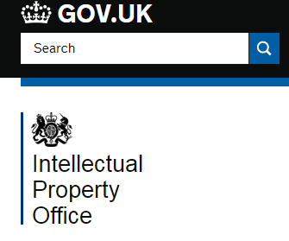




Different Types of Intellectual Property
Patents
Protect how something works
Protects an idea or discovery with a technical application
Granted by the state in exchange for disclosing the invention (and payment of fees)
Right to stop others from making or using commercially for a time limited period
Published patent applications provide a clear and complete description of invention (knowledge sharing)
Notes:
So next I will go quickly through most of them, will give you a short overview some examples but also highlight the value within biomedical science

Slide 17
Patents: protect how something works
Patentable inventions must:
Patentable inventions must not be:
A scientific or mathematical discovery, theory or method
A literary, dramatic, musical or artistic work
A way of performing a mental act, playing a game or doing business
The presentation of information, or some computer programs
An animal or plant variety, or naturally occurring phenomena (US)
A method of medical treatment or diagnosis
Against public policy or morality
Be new
Have an inventive step that is not obvious to someone with knowledge and experience in the subject
Be capable of being made or used in some kind of industry
Notes:
What is the advantage of my innovation?
What are the current/future competing solutions?
How big is the need/market for my technology?
Who are my customers?
How will it get to market?
What sort of IP protection is possible?
Is there any existing IP that my technology would infringe?
How can we exploit the IP?
How much proof of concept/supporting data do I have?
How much additional data do I need, how much will this cost and who will do the work?

Slide 18
Licensing or Spinout company?
What is the most efficient, route to commercialisation
Dependent on many factors including:
  Technology – one product or platform
  Complexity of technology – does expertise exist outside research group
  Ability (and desire) of founders, inventors
  Investment environment
A license
  Can be an efficient way to take a product to market
  Technology needs to be at the right stage to interest partners
Notes:
What is the advantage of my innovation?
What are the current/future competing solutions?
How big is the need/market for my technology?
Who are my customers?
How will it get to market?
What sort of IP protection is possible?
Is there any existing IP that my technology would infringe?
How can we exploit the IP?
How much proof of concept/supporting data do I have?
How much additional data do I need, how much will this cost and who will do the work?

Slide 19
UCL Revenue Sharing Policy
Net Revenue (£) | Originator(s) (%) | UCLB/UCL (%) | Department (%)
≤ £100,000 | 80% | 10% | 10%
> £100,000 but ≤ £1,000,000 | 50% | 30% | 20%
> £1,000,000 | 30% | 40% | 30%

Slide 20
Commercialisation of Translational Research
Part 1
An Introduction to UCL Business PLC
Why do Universities commercialise research
Part 2
Intellectual Property Rights and commercialisation
Patents
Part 3
UCLB case studies
Common success criteria
What to take away

Slide 21

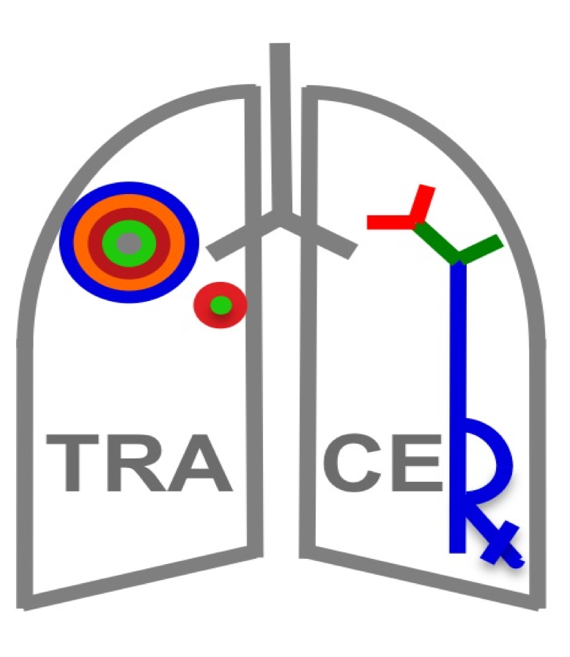
Background
  £14m CRUK sponsored TRAcking Cancer Evolution through therapy (TRACERx) - Prof Charles Swanton
  Multi-centered study across UK lasting over 9 years
  Analysing the intratumour heterogeneity helped to understand cancer evolutionary trajectory and have helped to develop a method to identify clonal mutation that are present in all cancer cells
Achilles Therapeutics – Immunotherapy Spin-out
  Founded in 2016 to develop next-generation, patient-specific therapies that harness the immune system to destroy cancer cells.
  Licensed IP that were developed as part of TRACERx and technologies developed at UCL and the Crick
  Clinical trial planned in near future
Notes:
For a cell to become cancerous, it needs to acquire a series of mutations in the genes encoded within its DNA. These mutations are specific to the cancer cell, and so are not found in the surrounding healthy cells. Certain mutations will trigger the transformation of a healthy cell into a cancer cell, which will begin to divide and grow. The mutations occurring before this transformation event will be carried by all of the cells of the growing cancer. We refer to these as ‘truncal’ mutations, akin to the trunk of a growing tree. As the cancer grows, its cells will accumulate further mutations, which may enhance the ability of the cancer cells to proliferate or disseminate. These later mutations are referred to as ‘branch’ mutations, as they are like the branches of a growing tree, and they will not be carried by all the cells that make up the whole cancer cell population in an individual.
Many of the mutations in the DNA of the cancer cell will lead to changes in the proteins encoded by the mutated genes, which can then be recognised by the immune system as ‘foreign’. As a consequence, these cancer-specific ‘neo-antigens’ can be targeted by immunotherapies, which will attack the tumour but not the healthy cells. However, if the therapy targets only the branch mutations, this will not result in the elimination of the whole cancer population, akin to pruning of specific branches, but not felling the entire tree. In order to attack the entire cancer, Achilles Therapeutics’ therapy will target the truncal mutations. This is the ‘clonal architecture’ of the cancer.
Achilles Therapeutics offers a new therapeutic approach to overcome this seemingly intractable problem; by targeting cancer’s Achilles’ heel we are exploiting the very mechanism that cancer cells use to evade traditional therapies.
Achilles Therapeutics is developing approaches to specifically target “truncal” neo-antigens, protein markers unique to each individual and expressed in all their cancer cells. Truncal mutations are not present on healthy cells and therefore provide an exquisite means to direct therapy to every cancer cell in an individual, whilst sparing healthy tissue.
Achilles Therapeutics’ technology brings together the most recent advances from two of the fastest developing fields in healthcare today: cancer bioinformatics and immuno-oncology, to bring a truly personalised medicine to patients. Achilles Therapeutics will use DNA sequencing data unique to each patient, alongside its proprietary bioinformatics technology, developed in the lab of Professor Charles Swanton (Reference Link), to identify truncal neo-antigens specific to

Slide 22

Background
  Chimeric Antigen Receptor (CAR) T-cell therapies have been shown to be effective in some haematological malignancies and may have wide applications potentially even offer a cure.
  Advanced cell programming technologies for CAR T-cell therapies, developed by Dr Martin Pule et al at UCL Cancer Institute and UCL ICH
  UCLB invested ~£150k in PoC (2010-2014) funding in addition to several £m of public and charitable grant funding
Autolus - Cell Therapy Spin-out
  Spun-out of UCL in 2014 to develop next gen CAR T-cell therapies
  UCLB has licensed >18 patent families
  UCLB holds equity in the company but also receives royalty and milestone payments from the technology licenses
  (currently) 4 programmes in the clinic
  Series A, B and C ~£130m
  IPO in summer 2018 ~ USD160m
Notes:
For many years, the cornerstones of cancer treatment have been surgery, chemotherapy and radiation therapy. Recent years have seen the emergence of cancer immunotherapy, in which treatments harness the power of a patient’s immune system to combat their disease.
T-cells are a type of white blood cell that form part of the immune system’s natural protection against cancer and infection. Normally our T-cells can detect and eliminate abnormal or cancerous cells but sometimes these cells can escape detection and develop into tumours.
To overcome this problem Autolus is applying its advanced cell programming technologies and specialised manufacturing processes to develop engineered T-cell immunotherapy products.
We use powerful Chimeric Antigen Receptors (CARs) or T-cell receptors (TCRs) to reprogramme T-cells to recognise and kill the tumour cell.
We maintain and enhance their natural ability to kill cancer cells through our specialised manufacturing process.
These novel therapies harness the anticancer potential of a patient’s own T-cells and enable the effective targeting and eradication of cancer cells.
Car-T cell therapy just approved Novartis - Kymriah(TM) (CTL019), for children and young adults with B-cell ALL that is refractory or has relapsed at least twice – cost ~half million USD
M&A activiti
Celgene confirms $9B Juno buyout
ess than the $11.9 billion that Gilead Sciences paid for Kite Pharma
Celgene bought by GSK

Slide 23

Background
  Gene therapy trials at GOSH lead by Bobby Gaspar and Adrian Trasher in ADA-SCID
  Patients were successfully treated
  Main IP clinical data
Orchard Therapeutics – Gene Therapy Spin-out
  Spun out from UCL in 2015
  Series A, B and C total of ~USD300m
  UCL/GOSH licensed 3 programmes incl. clinical data and other IP
  Focus on ex-vivo autologous haematopoietic stem cell gene therapies
  Additional licenses from University of Manchester, Genethon, UCLA and Boston Children’s
  Aqcuired GSK assets in April 2018
  IPO in November 2018 raised USD225
Notes:
The company will focus on the development of lentiviral gene therapies for ultra-orphan indications such as ADA deficiency (a programme developed jointly with UCLA), mucopolysaccharidosis, type 1 (MPS1) IDUA gene mutation and HLH perforin deficiency. The UCL programmes are the cornerstone of network of gene therapy experts pulled together by UCL and Fprime. F-prime is in late stage negotiations with University of Manchester, Genethon and Boston Children’s to bring in four additional (three clinical stage) programmes.
Autologous ex-vivo gene therapy technology makes use of the patient's own stem cells (autologous)
These stem cells are taken from the patient (step 1) and genetically corrected outside of the body (ex-vivo) with a lentiviral vector carrying a functioning copy of the missing or faulty gene (step 2)
The genetically corrected cells are then transplanted back into the body (step 3)

Slide 24

Background – Gene therapy license
  Professor Amit Nathwani leads haemophilia clinic at Royal Free Hospital and is leading on gene therapy for haematological disorders research
  Background UCL and St Jude Children’s Research Hospital developed a novel adeno-associated viral vector (AVV) for gene therapies
  Developed codon optimised sequence and promotor for Factor VIII
BioMarin – Exclusive gene therapy license
  Exclusively licensed to BioMarin in February 2013
    Optimised FVIII gene therapy cassette.
    Specific Factor VIII AVV vector
  BioMarin clinically develops the project
    Valoctocogene roxaparvovec positive read outs in Phase I/II that suggest a one-time infusion of valoctocogene roxaparvovec has the potential to eliminate bleeds and the need for exogenous factor VIII infusions
    Currently in Phase III
Notes:
Hemophilia A is a genetic disease caused by the deficiency of clotting factor VIII. It is the most common type of hemophilia and occurs much more frequently in males; incidence is estimated at 1 in 4,000-5,000 male births.
People born with hemophilia produce little or no clotting factors. The two main types of hemophilia are A and B. People with hemophilia A are missing or have low levels of clotting factor VIII.
Platform, licensed for A now have also generated a company called freeline that use similar technologies to treat patient with haemophilia B
People with hemophilia B are missing or have low levels of clotting factor IX. These proteins work with platelets in the clotting process. When blood vessels are injured, clotting factors help platelets stick together to plug cuts and breaks on the vessels and stop bleeding. Many patients with hemophilia experience spontaneous bleeding events that result in progressive and debilitating joint damage

Slide 25
Common Success Factors
Interdisciplinary projects
  Develop technologies that fulfil a specific clinical need
Perseverance in emerging sectors
.
1
Strong clinical input
Clinical support to trial and champion the technology
6
2
  Early interactions with TTO and MHRA
Focus on (rare and/or orphan) specific indications
5
3
4
Utilizing non-dilutive funding
  Available for Universities and Companies
  Wellcome Trust, NIHR, MRC, Cell and Gene Therapy Catapult
  Available for clinical trials
.

Slide 26
How can UCLB help?
As a UCL employee, you are obliged to assign rights of your innovation to UCL. UCLB can get involved
Discuss ideas to determine whether something is commercially viable
Prior art searches, investigate market size and need
Discuss what IP protection is possible
Discuss further studies that would support IP/demonstrate proof of concept
Discuss strategies for commercialising the innovation
Find potential funding options – help with grant applications

Slide 27
Caitriona O’Rourke
c.orourke@uclb.com

