Slide 1
Digital Accessibility
The new regulations and what they mean for UCL’s digital platforms
Samantha Fanning, Head of Digital

Slide 2
What it means to be accessible - POUR
Perceivable – content can be accessed using the senses
Operable – can be operated by all (buttons, keyboard, voice, etc)
Understandable – predictable navigation, language
Robust – works reliably on different platforms

Slide 3
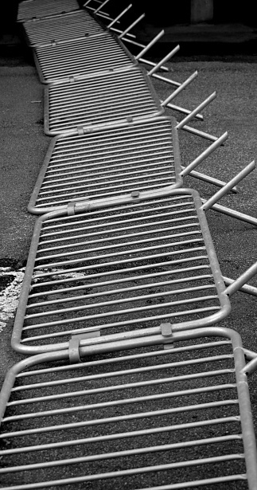
Common barriers
Barrier | Who is affected
Poorly structured and signposted web pages and Moodle courses. | Everyone.
Poorly structured and tagged documents. | Principally screen-reader and keyboard-only users, but everyone will find clear structure and navigation helpful
Poor colour contrast, or using colour as a sole method to communicate. | Visually impaired and dyslexic users.
Images without alternative descriptive text. | Screen-reader users.
Inaccessible PDFs (especially ones based on scanned images). | Screen-reader users and dyslexic user.
Media content without subtitles, captions or audio descriptions. | D/deaf, dyslexic users and non-native English.

Slide 4

New legislation
The EU Directive on the accessibility of public sector websites and mobile applications.
The Public Sector Bodies (Websites and Mobile Applications) Accessibility Regulations (2018).
Accessible VLEs – the ‘Policy Connect’ Briefing (The easy read).

Slide 5
What’s in scope?
Websites and intranets (both the platform, and the content. Digital Presence are generally responsible for the accessibility of platforms used within their service; website editors are responsible for the content.)
Documents on websites and intranets
Videos and multimedia content
Libraries
Student portals
Staff systems
Apps
Purchased third party content and tools

Slide 6
Timescales
Public-facing websites
New or updated online content published on or after 23 Sept 2018 has to comply by 22 Sept 2019.
Existing sites (published before 23 Sept 2018) must comply by Sept 2020.
Intranets (behind a password)
New or substantially revised content published on or after 23 Sept 2019 to comply with the requirements of the regulations on publication.
Intranet content published before 23 September 2019, doesn’t have to be brought into compliance at a fixed point; they must instead be brought into compliance only when first substantially revised on or after 23 September 2019

Slide 7
Exemptions
Pre-recorded media published before 23 Sept 2020
Live audio and video
Third party content that UCL didn’t pay for or develop (e.g. external social media content)
Heritage collections – e.g. scanned manuscripts
Online maps
Archived websites if they are not needed for services we provide
Get out of jail free

Slide 8

Disproportionate burden
To declare that making particular things accessible is a disproportionate burden, we must weigh up:
the burden that making those things accessible places on UCL
the benefits of making those things accessible
We need to think about:
UCL’s size and resources
how much making things accessible would cost and the impact that would have on UCL
how much users with a disability would benefit from us making things accessible

Slide 9

Monitoring & enforcement
Government Digital Services (GDS) will monitor and report
Equalities and Human Rights Commission (EHRC) is the enforcement body
Both will aim to provide a proportionate, corrective and supportive mechanism for compliance – they don’t want us closing down sites
Sample of 2055 sites initially

Slide 10
Grey areas
There are quite a few, not least
  how much needs to be done to improve accessibility of individual files in Moodle;
  what level of video captioning is needed;
  what constitutes a disproportionate burden.

Slide 11
Work done to date
Samples of website, Moodle, online library (Jisc snapshots)
New online guidance created
Awareness-raising in the academic community
Liaison with Jisc, GDS, Ucisa, across the sector
Established a Task And Finish group with cross-institutional representation

Slide 12
What can we all do?

Slide 13
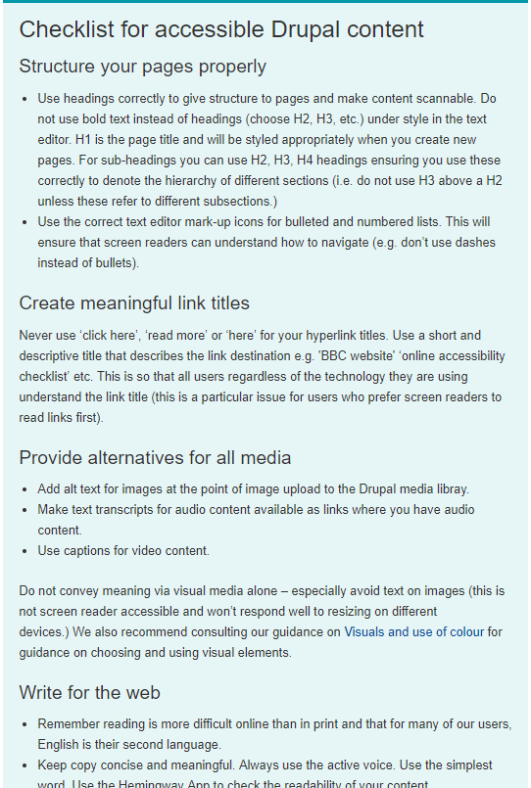
For Drupal, use the guidance at: https://www.ucl.ac.uk/isd/services/websites-apps/creating-accessible-content/websites-wikis-and-blogs
This covers:
Structuring content
Accessible links
Adding alternatives for rich media
Writing for the web
Creating accessible documents

Slide 14
For Moodle, use the baseline…
Meaningful structure with:
  Section overviews.
  Group and label content
Consistent navigation
  Labelling
  Templates and consistency across courses
Presentation
  Clear layouts
  Good spacing
  Text that isn’t cramped, or dense

Slide 15
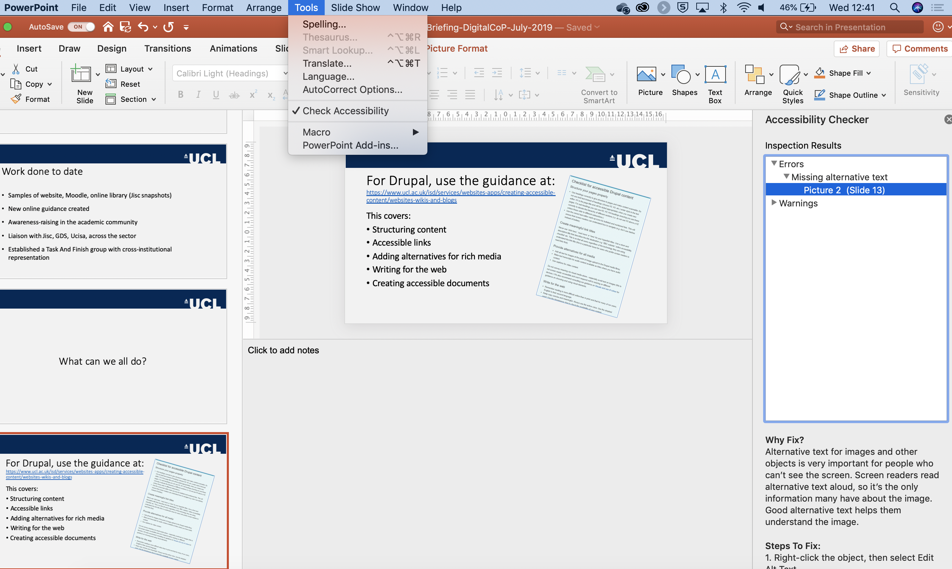
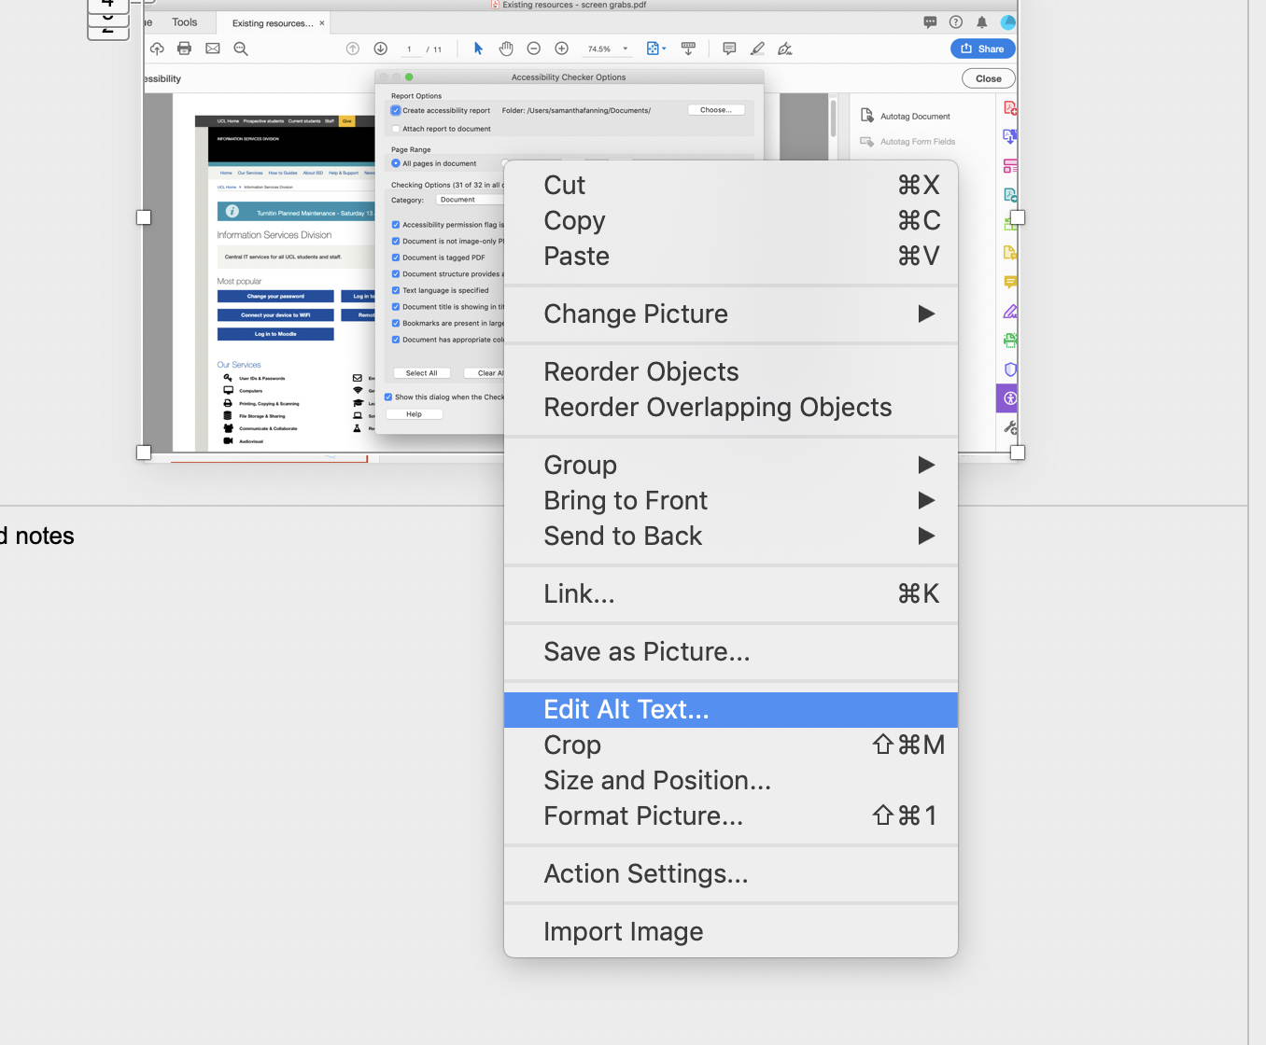
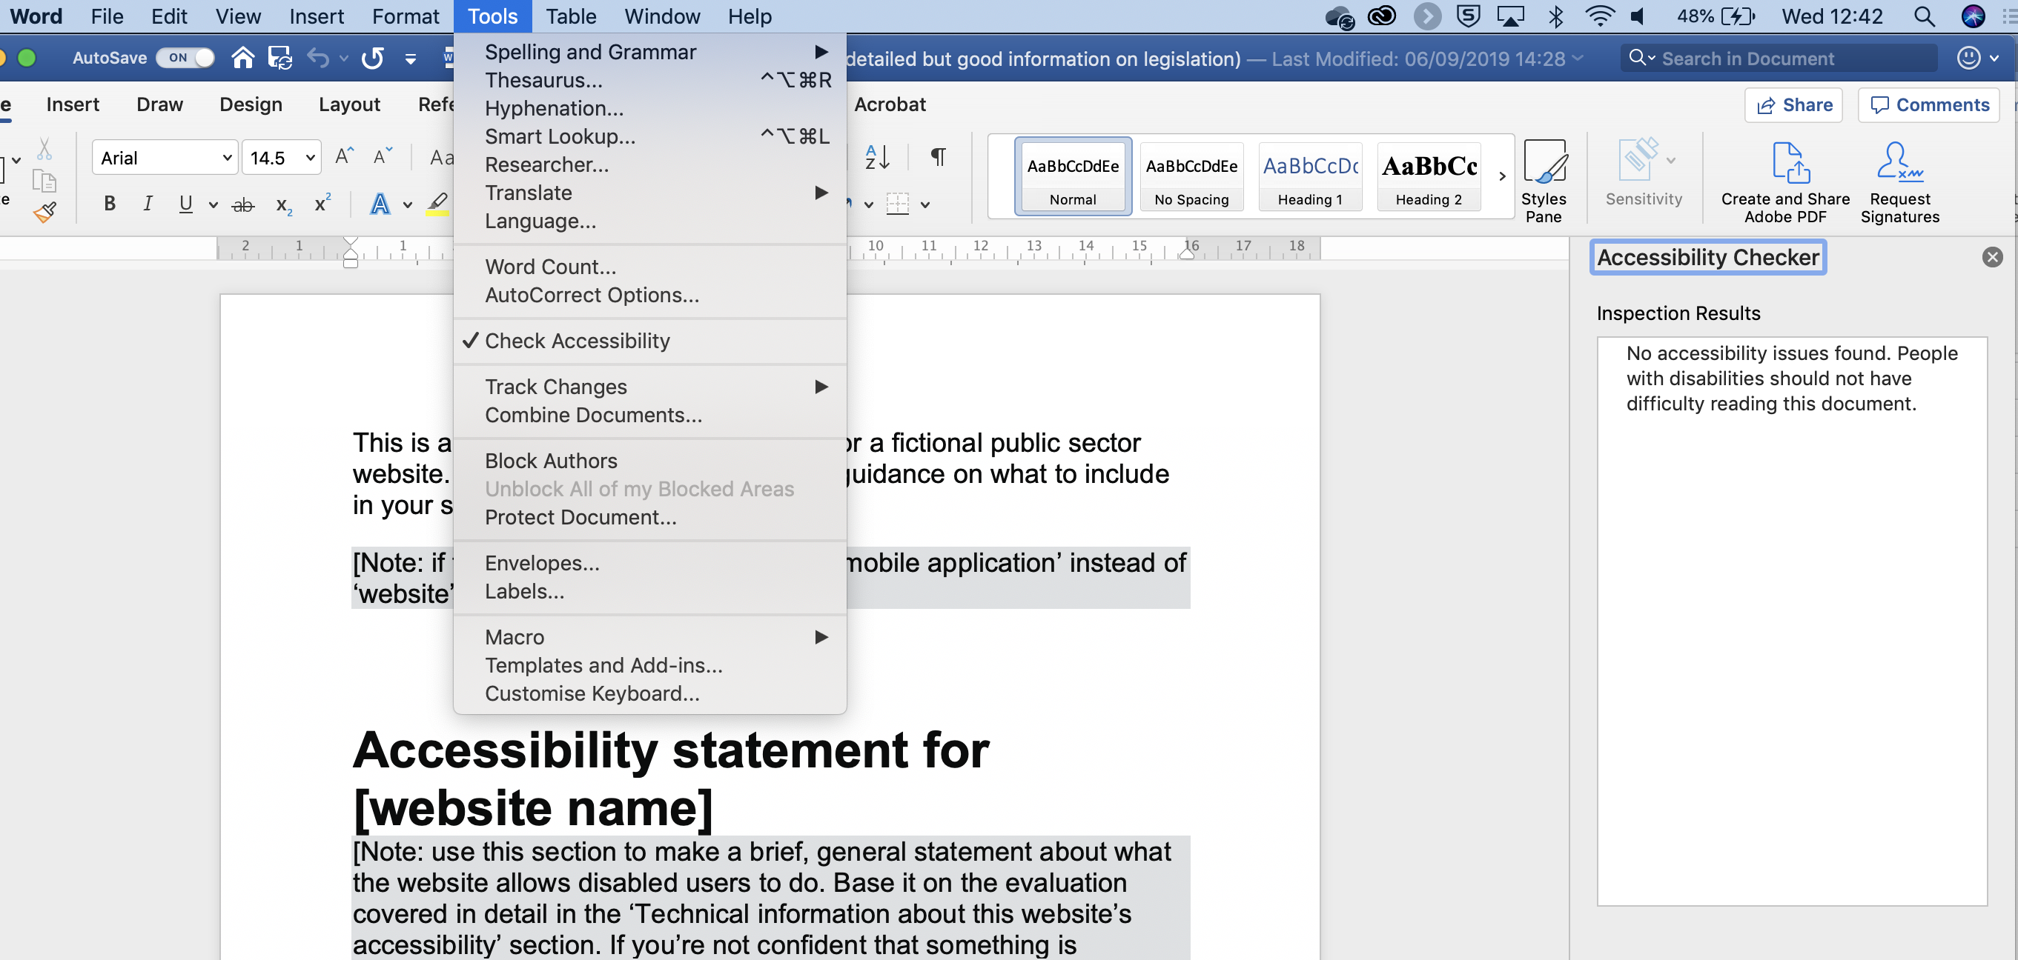
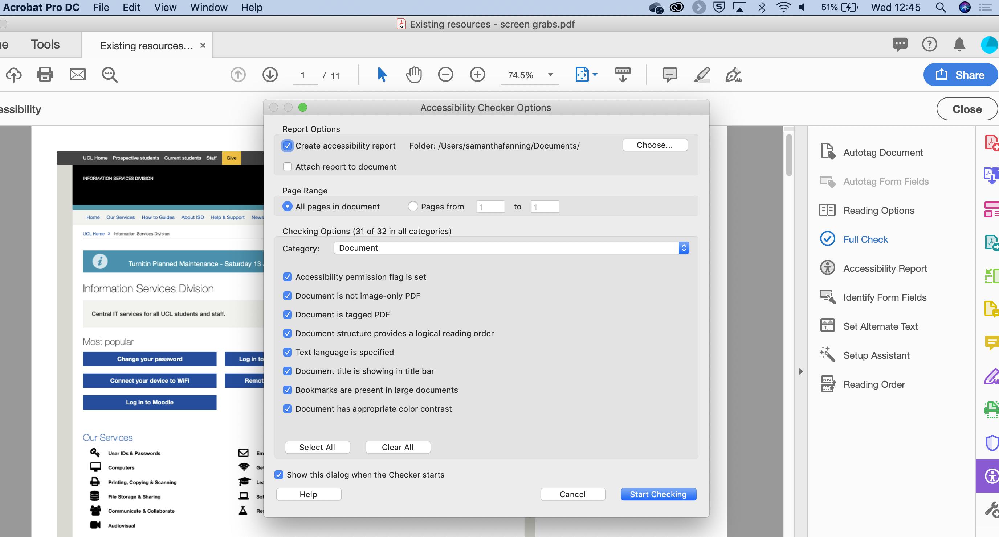
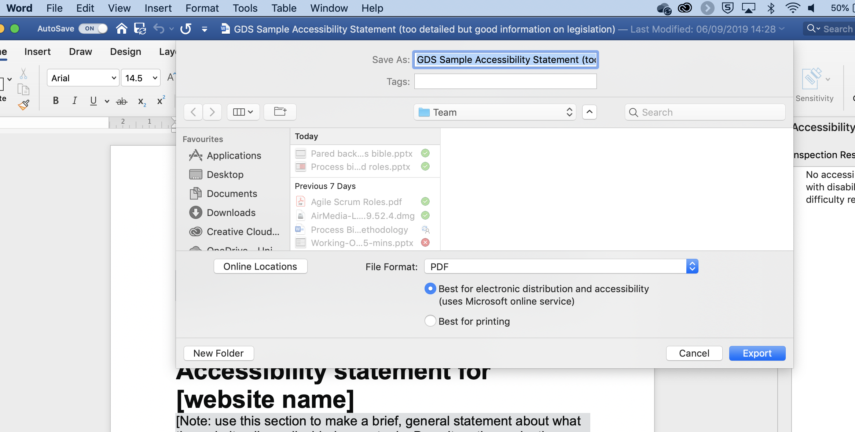
For documents…
Word, Powerpoint both come with excellent accessibility checkers
Always select the accessible option when creating PDFs
Enable any accessibility tools option in Acrobat

Slide 16
Where to get help and advice
UCL guidance
  Creating Accessible Content – online guidance
  Accessible Teaching Practices – self-paced Moodle course
  E-learning baseline – minimum expectations for Moodle course design
Government Digital Service
  Guidance on the legislation
  Nice set of “dos and don’ts” posters
Getting started with accessibility and inclusion – overview from Jisc

Slide 17
More info and help:
http://www.ucl.ac.uk/digital-accessibility
web-support@ucl.ac.uk
digitalaccessibility@ucl.ac.uk

